Slide 1
Measuring and Valuing Australia’s Ecosystems
Jonathon Khoo, Koenraad Van Landegham and Takako Wakiyama
03/12/2025

Slide 2
Outline
Introduce the System of Environmental-Economic Accounting (SEEA), ecosystem accounting and why it is important
Valuation concepts and methods
Examples from National Ecosystem Accounts

Slide 3
SEEA, ecosystem accounts and SNA

Slide 4
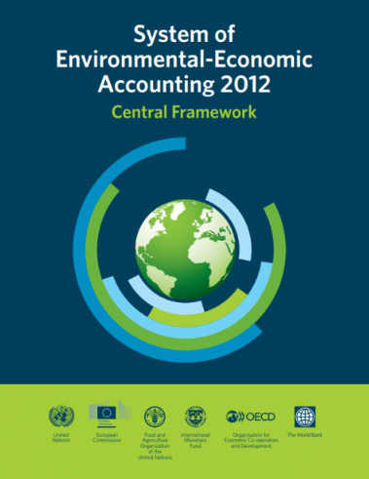
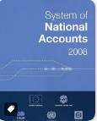
Relevant frameworks: SEEA CF, production boundary
Environment
Economy
Natural inputs (e.g. minerals, energy, timber, fish and water)
Mineral and energy resources
Timber resources
Fish resources
Water resources
Soil resources
Land
Enterprises,
Households &
Government
Products
Residuals (e.g. air emissions, solid waste, return flows of water)
Source: SEEA 2012, United Nation
Notes:
Do for the environment what the national accounts have done for the economy

Slide 5
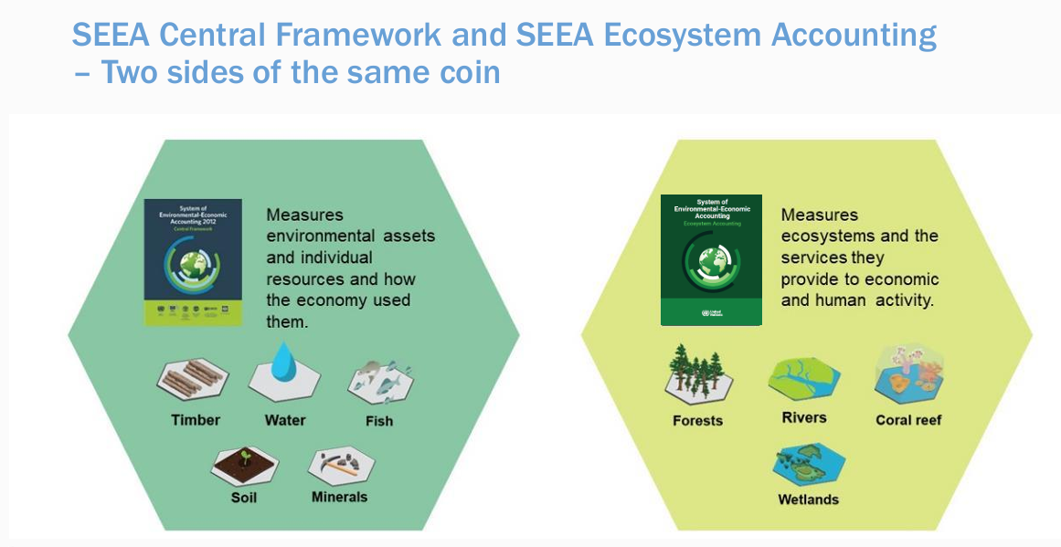
SEEA accounts
Source: SEEA 2012, United Nation

Slide 6
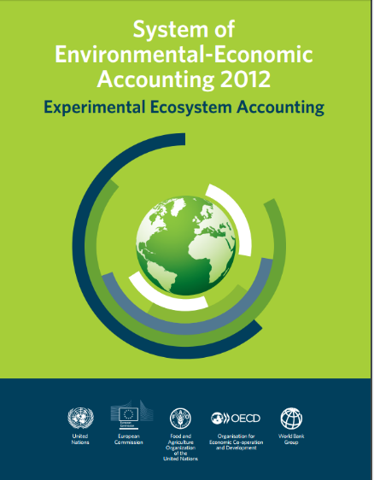
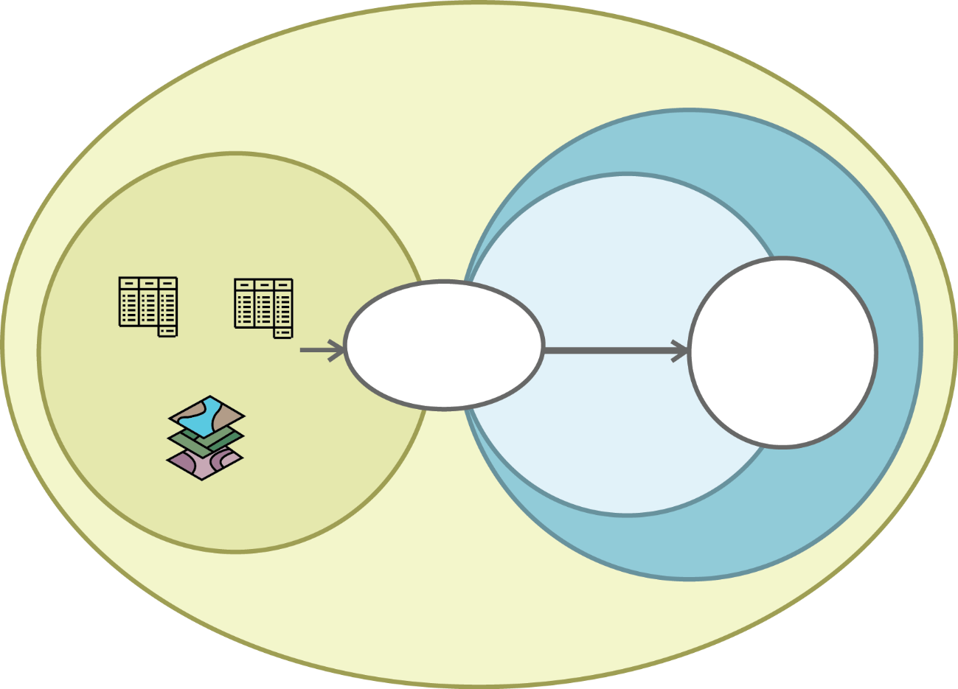
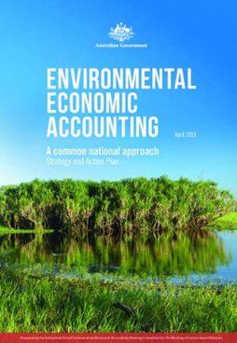
Relevant frameworks: SEEA EA
Environment
Society
Ecosystem assets
Provisioning
regulating
cultural
Economy
Extent
Condition
Final ecosystem services
Benefits
Characteristics
Source: SEEA 2012, United Nation
Notes:
Key Challenge: How can EEA move beyond the experimental phase and mainstream the accounts to support practical decision-making by communities, business and governments?

Slide 7
Valuation concepts and methods

Slide 8
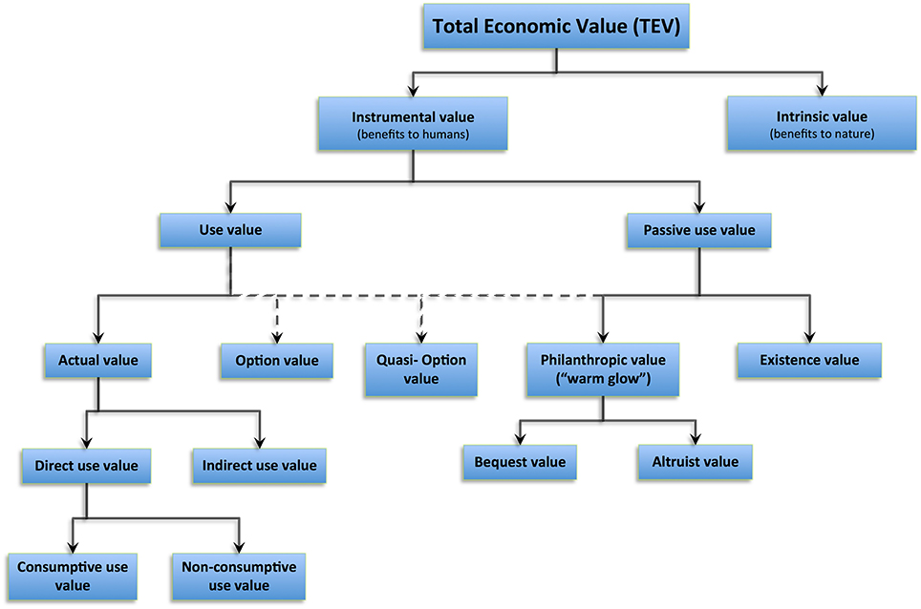
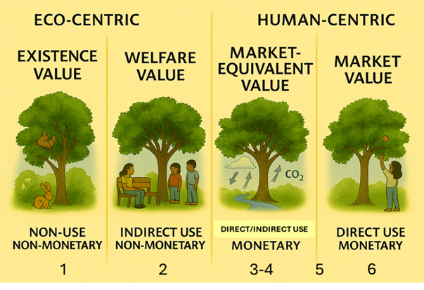
Total Economic Value
Source: Baveye PC etc (2016) Soil “Ecosystem” Services and Natural Capital: Critical Appraisal of Research on Uncertain Ground. Front. Environ. Sci. 4:41. doi: 10.3389/fenvs.2016.00041

Slide 9
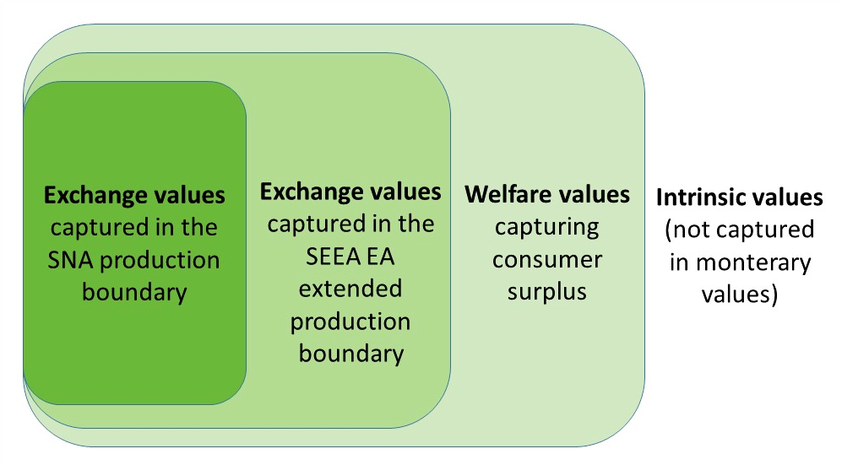
Measurement
Source: Schenau, S. and Mosterd, R (2024). Publishing and interpreting data from the monetary SEEA Ecosystem accounts. Statistics Netherlands

Slide 10
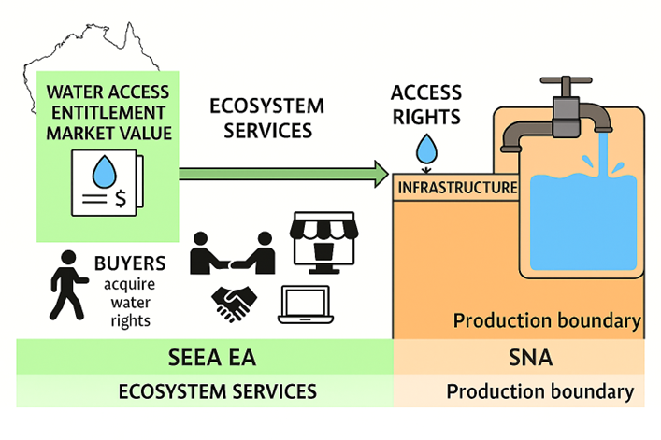
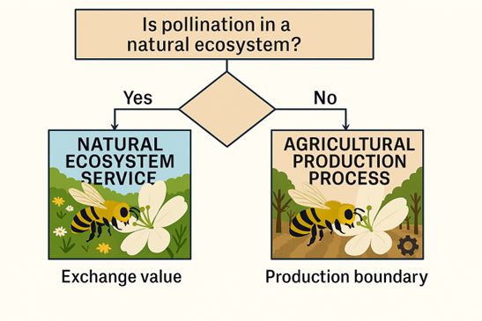
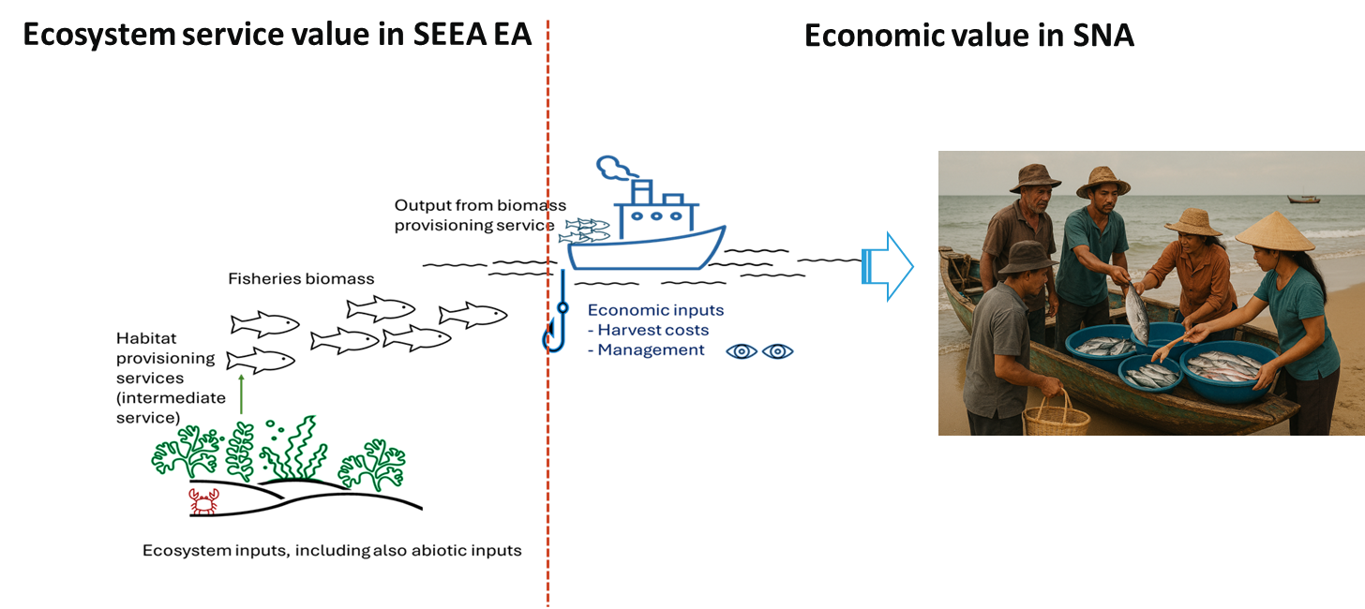
Examples
Picture: Generated by AI Copilot

Slide 11
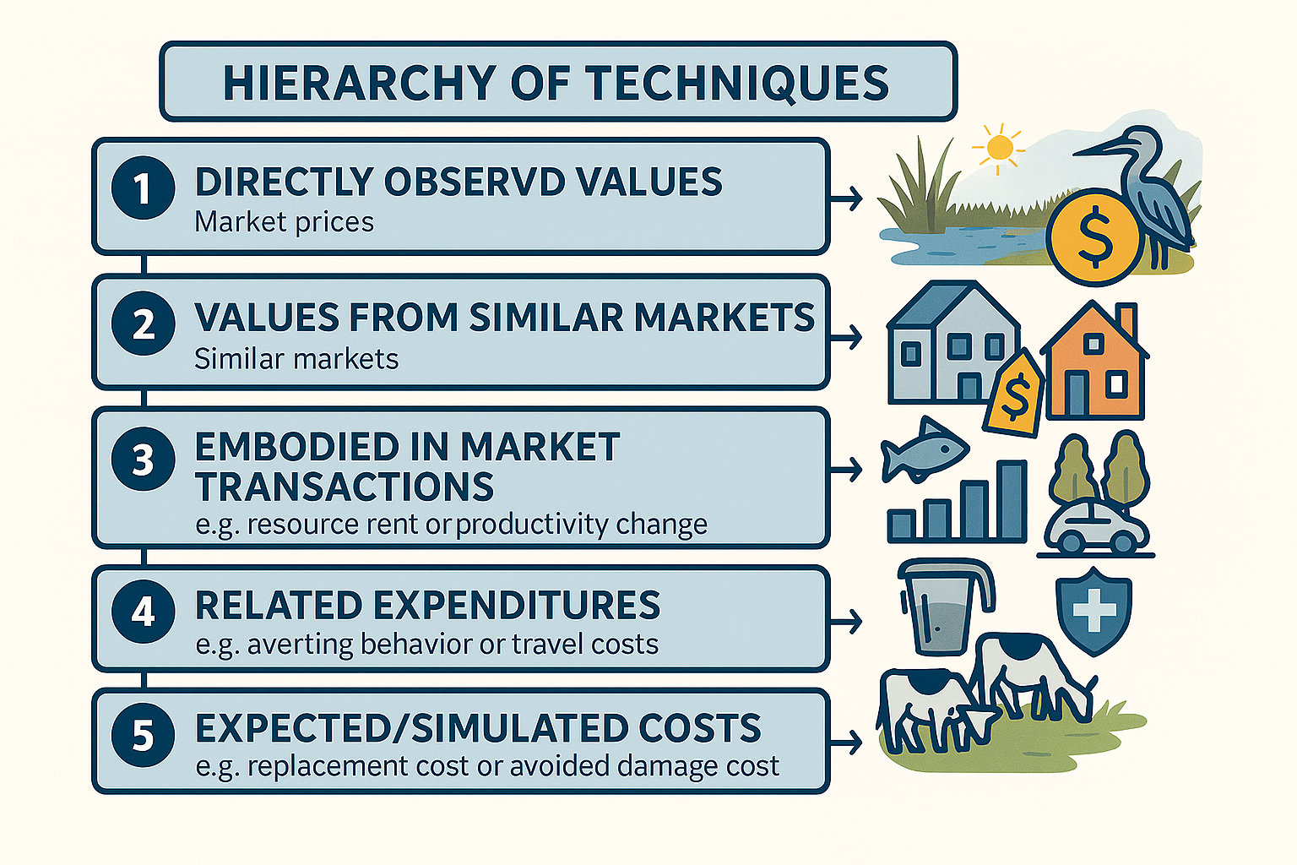
Hierarchy of valuation methods
Picture: Generated by AI Copilot

Slide 12
Australian National Ecosystem Accounts - examples

Slide 13
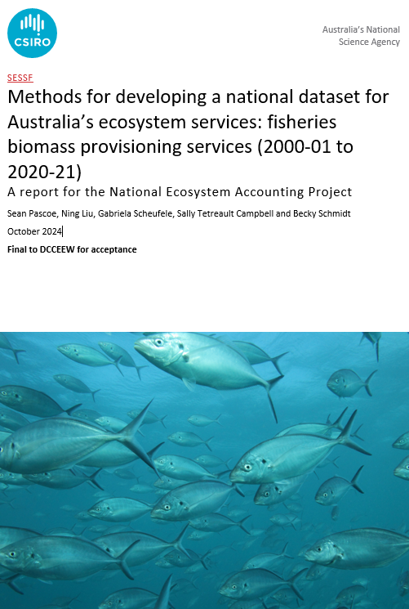
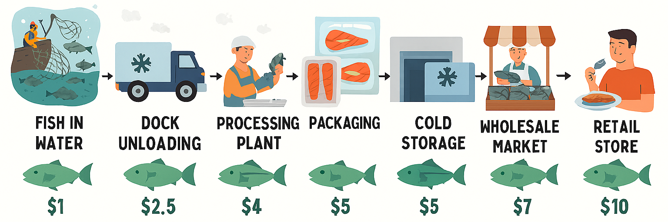
Wild fish provisioning services
Source: Pascoe S et al (2025) Methods for developing a national dataset for Australia’s ecosystem services: fisheries biomass provisioning services (2000-01 to 2022-23). A report for the National Ecosystem Accounting Project CSIRO, Australia
Price for the ecosystem service is directly observable.
In the context of individual transferable quota fisheries, this would be captured by the lease price of quota, assumed to reflect the annualised resource rent associated with a marginal unit of catch.
These use rights are transferable, they may be sold (permanent transfers) or leased (temporarily transfer) to other fishers, with the price of each established in a competitive market.
Rent Revenue Share of fishery F in time t
= Discount rate, Average value of quota/licenses held by vessels
/ Average revenue of vessels
Picture: Generated by AI Copilot
Average revenue of vessels in the fishery F in time t
Notes:
Three separate measures of the rent revenue share were derived. The lease price in each of the three years were scaled using an index of catch per unit of fishing effort. Given the high value of the fishery, estimates of the rent revenue shares were derived for the missing years based on estimated changes in stock conditions
RRS = the ratio of the average vessel licence value—or, for single-species fisheries, the quota transfer value per kilogram—against the average vessel revenue or average quota price, which means the estimated rent (annualised total quota sales value or licence value) at the fishery level divided by the total revenue.
Foremost of these is the use of methods where the price for the ecosystem service is directly observable. In the context of individual transferable quota (ITQ) fisheries, this would be captured by the lease price of quota, assumed to reflect the annualised resource rent associated with a marginal unit of catch; and quota sales price, reflecting the discounted future value of (expected) resource rent associated with the species (Newell et al. 2005; Pascoe et al. 2019; Gunnlaugsson et al. 2020), and assumed to reflect the value of the ecosystem asset. For non-quota (input controlled) fisheries, the licence value may similarly be expected to reflect the discounted future value of (expected) resource rent associated with operating in the fishery as a whole
An ITQ system involves a total allowable catch, with the rights to a portion being allocated to individual fisheries. Where these use rights are transferable, they may be sold (permanent transfers) or leased (temporarily transfer) to other fishers, with the price of each established in a competitive market.
Input controlled fisheries do not have an explicit total allowable catch, but access to the fishery is limited through a licence. Other restrictions on the operations of the fishers are also often present (e.g., closed areas or seasons, restrictions on fishing gear etc).

Slide 14
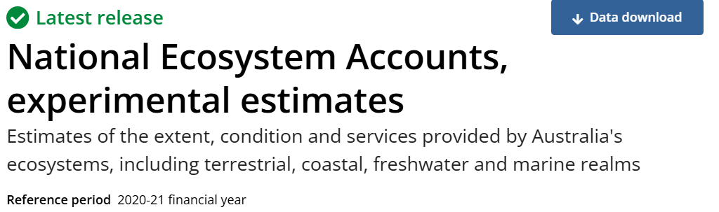
Results
$39.2 million
56.3 kilotonnes of fish
from
14% of GVP for commonwealth fisheries
or

Slide 15
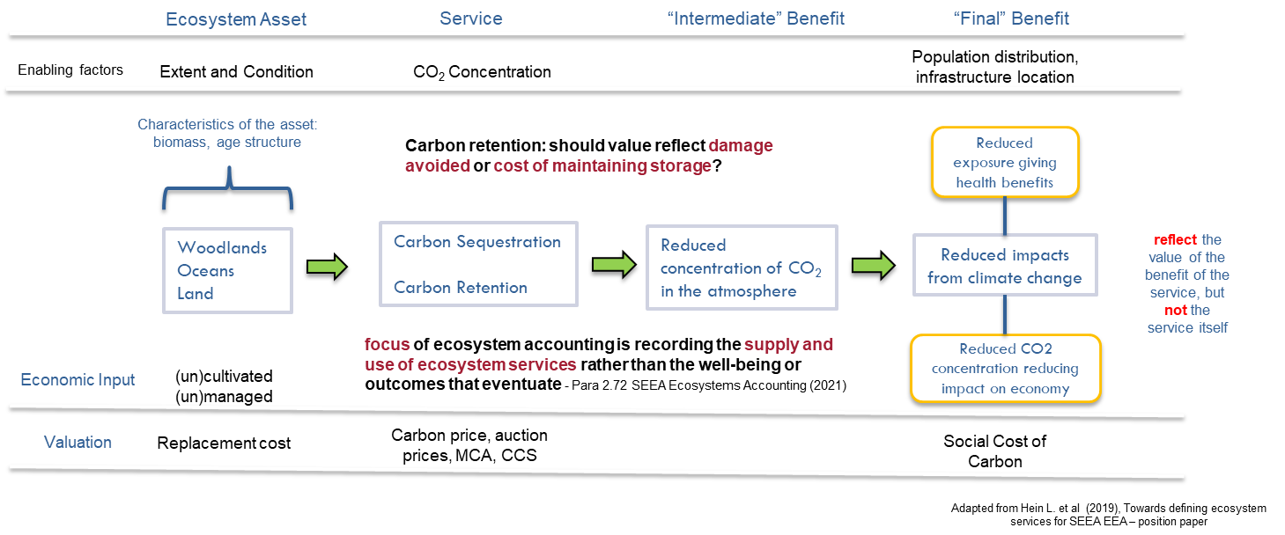
Logic Chain for climate Services – carbon retention

Slide 16

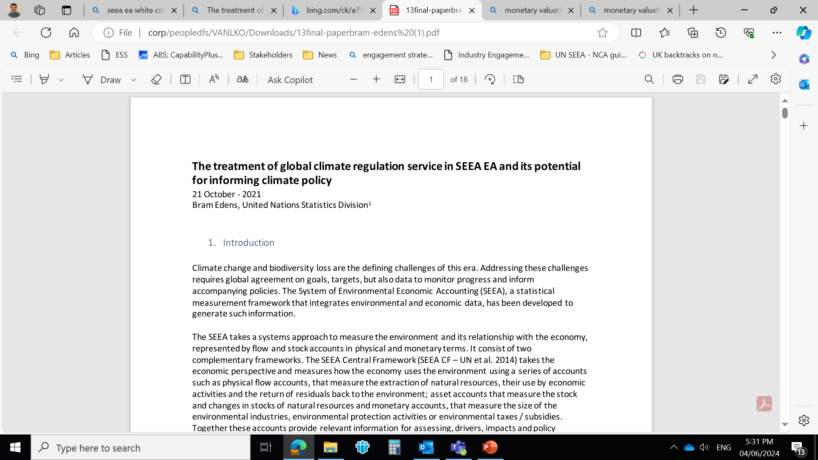
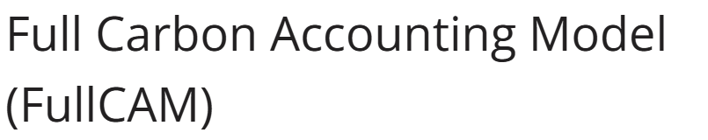

What price/value carbon?
Carbon retention (storage)
Consists of:
estimating carbon stocks of relevant carbon pools retained at the beginning of the accounting period;
multiplying this by a suitable carbon price; and
turning this into an annual service flow by multiplying this value by a suitable rate of return/discount rate (to create an annuity).
Stock (tC₀)
Pc
r
Institutional settings determined – ACCU auctions
Stock (tC₀) * Pc * r
Australia uses a NPV approach to estimate the value of mineral and energy resources. The ABS has historically maintained a real discount rate of 4%.
an annual rental value represents a return to the owner of the asset by linking stored carbon to the underlying asset
Notes:
­The rental value is based on the interaction of the Clean Energy Regulator’s auction price for Australian Carbon Credit Units, the CPI and an expected rate of return. The rate of return is assumed to be the (social) real discount rate of 4% as many ecosystems are held by the Crown. All in nominal terms.

Slide 17
Results
$45.8 billion
36.5 million kilotonnes
from
stored by selected ecosystems

Slide 18
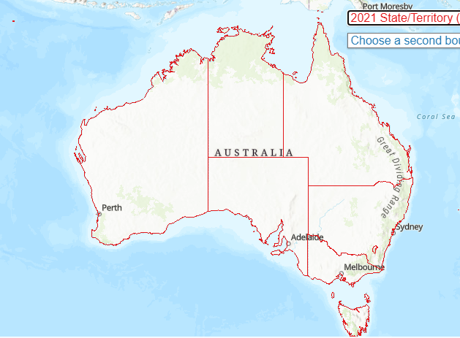
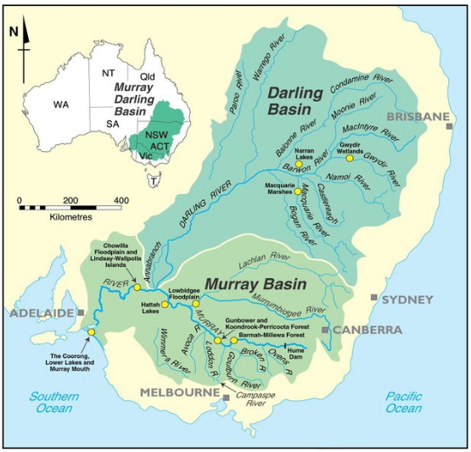
Water provisioning services
Australia has relatively advanced water markets, with large volumes of water traded through established water trading schemes.
Under these schemes, participants can buy and trade water access entitlements, which provide a perpetual right to an annual allocation of water.
To value surface water supply used as a material and used for drinking, the ecosystem price is multiplied by the physical quantity of supply.
QLD
SA
NSW
VIC
BOM data
Coverage
Commonwealth
State
private
Water access rights
Price
volume
Exchange value ($) = P ($/ML) *SW flow (ML)
P = Jurisdiction median price ($/ML)
W flow = physical surface water provisioning flow (ML)
Picture: Overton and Doody (2012). The Murray-Darling Basin: Ecosystem Response to Drought and Climate Change
Notes:
Data on tradable surface water allocations has been sourced from the Bureau of Meteorology (BOM). Data sourced from BOM includes reported data from a range of Commonwealth, state and private sector sources. The data includes volumes and prices on water access rights, trades or leases of water access entitlements and allocations.
Monetary supply and use values for water provisioning services comprise median $/ML values by state and at a national level; using the prices reported on allocation trades. Median surface water prices have been aggregated to produce a median allocation trade price ($/ML) by state, for states which have water allocation trades of surface water resources. The BOM dataset does not have water price data on the Northern Territory and Australian Capital Territory. Analysis of the dataset showed a wide distribution in prices for water within a given year, within individual states. To avoid the impact of large outliers distorting price estimates, the median price point for each state has been used.

Slide 19
Results
$1.37 billion
10.44 million megalitres
from
supplied by selected ecosystems

Slide 20
Challenges

Slide 21

Challenges
01
Complexity and Confusion on what values to focus on and what they represent.
Has led to inconsistent application of techniques such that values are not comparable and do not even focus on the same concept of value of the environment.
02
Drawing on broad national accounting principles, the SEEA framework places structure on nature’s contribution to society.
Good valuation requires good physical measurement of ecosystem services.
Be careful not to fall into the trap of trying to value the outcomes without reference back to the ecosystem – after all, the SEEA framework provides the foundation for supply-use tables.
If we solely focus on the use or benefit component we miss the supply side such that we miss the ecosystem aspects
03
Notes:
1. There is considerable confusion on what values to focus on and what they represent. The result is that we’ve seen inconsistent application of the techniques such that values are not comparable and do not even focus on the same concept of value of the environment.
2. The SEEA framework is a limiting framework because it focusses on nature’s contribution to society and it draws on the broad principles of national accounting. That is deliberate to encourage consistency in our treatment of how we value nature in an accounting framework. In contrast, environmental economics encompasses a much broader suite of approaches and scope that meet a variety of purposes – not all of these are appropriate in the context of the SEEA and are not conceptually
3. In considering the value of ecosystems we must be careful not to fall into the trap of trying to value the outcomes without reference back to the ecosystem – after all, the SEEA framework provides the foundation for supply-use tables. If we solely focus on the use or benefit component we miss the supply side – which will affect our estimates.
Practitioners recognise that not all techniques are fit for purpose in the SEEA guidelines so that they can concentrate their effort on those techniques that produce meaningful and credible results. (include?)

Slide 22
Questions?

