Slide 1
Improving housing price inflation statistics: developing methods and using new data sources
Aimee North
Head of Housing Market Indices
Prices Division
Office for National Statistics

Slide 2
Recent developments at ONS
 | Price Index of Private Rents (PIPR) | UK House Price Index (UK HPI)
New or expanded use of administrative data? | ✓ | ✓
Development of methods? | ✓ | ✓

Slide 3
HPI and PIPR: generating the price index
1. Link price transaction and property attributes data
2. Run our regression model
3. Use our modelled prices to calculate our price index
4. We apply
the index to a reference set
of properties to get price levels

Slide 4
Rents development

Slide 5
Rents development
IPHRP
Matched pairs approach
Splits data into a sample and substitution pool
PIPR
Hedonic regression model
Uses all data
Region-level analysis
Local authority level analysis

Slide 6
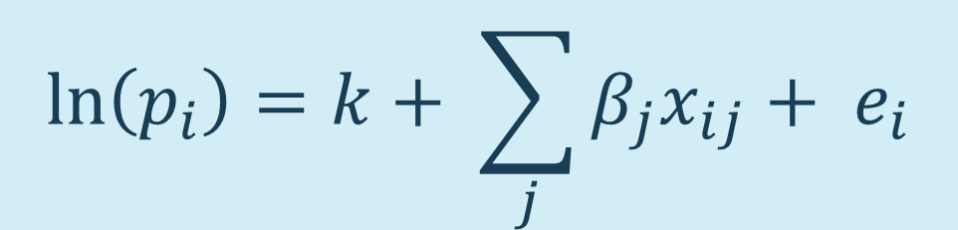
Regression model: UK-wide or per country?
$$\ln\left(p_{i}\right)=k+ \sum_{j}{β_{j}x_{ij}}+ e_{i}$$
number of bedrooms
furnished status
property type (detached,
semi-detached, terraced,
flat or maisonette)
log of floor area (England, Wales and Northern Ireland)
geo-demographic segmentation (ACORN)
local authority (England and Wales)
broad rental market area (Scotland and
Northern Ireland)
property age bracket

Slide 7
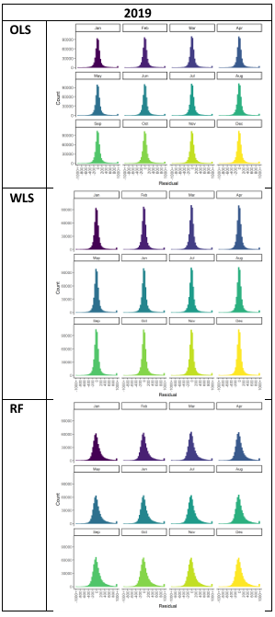
Rents development: OLS, WLS or random forest?

Slide 8
Rents development: why did we select OLS?
OLS and WLS performed similarly well, but outperformed random forest
OLS and WLS are well-established in literature
OLS is more transparent, easily described and understood by users
OLS has the widest technical expertise within ONS, posing lowest risk to statistical production
OLS is used in other statistical agencies, increasing international coherence

Slide 9
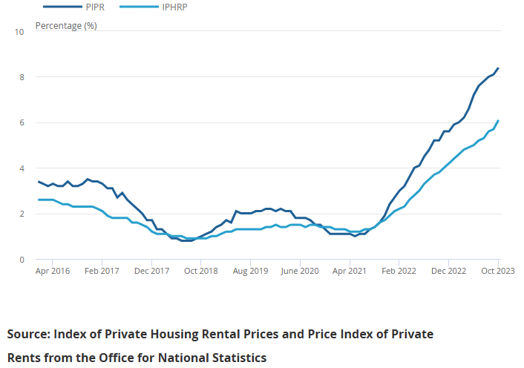
Results: PIPR vs IPHRP

Slide 10
UK HPI development

Slide 11
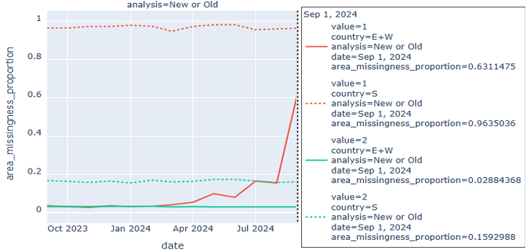
UK HPI: source of new build over-estimation
September 2024 (1st estimate)
Country = England & Wales
Value = new build
Missingness proportion = 63%
Country = Scotland
Value = new build
Missingness proportion = 96%
Country = England & Wales
Value = old build
Missingness proportion = 3%
Country = Scotland
Value = old build
Missingness proportion = 16%

Slide 12
UK HPI: imputation options
Median
CanCEIS nearest-neighbour
K nearest neighbour
K nearest neighbour using postcode coordinates

Slide 13
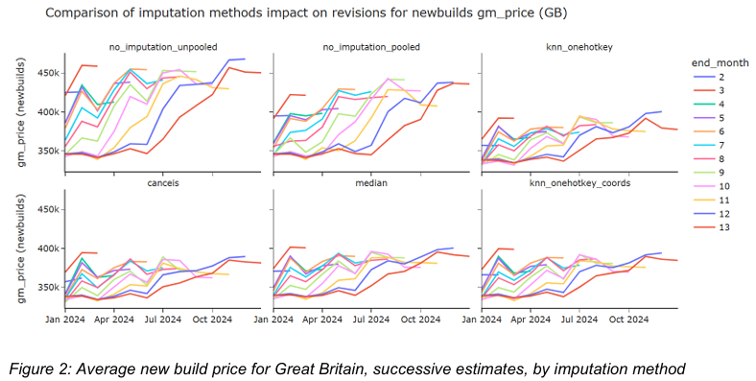
UK HPI: imputation investigation

Slide 14
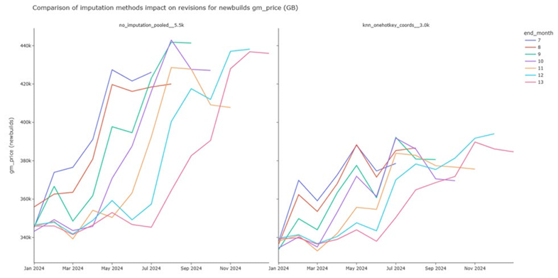
UK HPI: selected imputation improvement

Slide 15
UK HPI: selected imputation improvement
Variable | Previous method | Improved method
Floor area | England & Wales: set to zero | England & Wales: imputed using 10 nearest-neighbour imputation
 | Scotland: set to zero | Scotland: set to zero
Number of rooms | Great Britain: missing indicator | Great Britain: imputed using 10 nearest-neighbour imputation

Slide 16
Results: UK new build annual inflation
Redacted from published slides

Slide 17
Results: UK new build annual inflation
Redacted from published slides
Next steps:
Continue monitoring impact of this interim improvement
Launch of wider HPI methods review in 2026

Slide 18
Any questions?
Email: hpi@ons.gov.uk

