Slide 1

The construction of an experimental gender-based account for Australia
How has gendered activity contributed to Australia’s economy for the past three decades?
Ting Li and Mary Farrugia

Slide 2
This paper shares preliminary research and statistics on measuring digital economy within health activity from a thematic and extended accounts perspective. The views expressed in this paper are those of the authors and contributors, and do not necessarily reflect the opinions of both departments.

Slide 3
Outline
Background
Why do we need a gender-based account?
Framework and Methodology
Key findings
Conclusion and future study

Slide 4

Background
The Australian economy has transformed significantly over the past three decades, driven by economic, technological, and social shifts.
Major events like the mining boom, the GFC, COVID-19, and emerging technologies such as AI have collectively influenced the nature and distribution of gendered activity.
Female labour force participation now accounts for approximately 48% across all industries in the Australian economy, with evolving gender roles supported by government policies on child care and protected leave, allowing women to return to work after childbirth.
However, gendered inequality remains, with notable economic and societal implications.
There is growing international interest in quantifying the economic contribution of gendered activity to understand the reasons better and address its broader impacts.
Within industry preferences and occupational roles, a gender gap persists in economic contribution. Quantifying the monetary value of gendered activity – both paid and unpaid – provides critical insights into these inequities.
This includes examining industrial and occupational contributions as well as unpaid household and volunteer work.

Slide 5

Why do we need a gender-based account?
This paper estimates the gendered activity in Australia over the past thirty years, from a thematic and extended account perspective, that includes market production and unpaid work from 1994-95 to 2023-24.
The analysis estimates gendered contributions across more than 500 Australian industries by using ABS data and examines the gendered dynamics within the digital economy industries for the past decade.
This approach lays the foundation for future research exploring the intersection of gender and thematic accounts, such as the digital economy, care and support economy, and cultural and creative activities.
The paper emphasises the interconnections between market and non-market work, providing a comprehensive view of gendered activity and its impact on Australia’s economy and society.
The study incorporates the individual function replacement cost method to estimate monetary values to unpaid work.
By integrating both market and non-market outputs, this paper contributes to a deeper understanding of gender inequality. It offers a foundation for evidence-based policies aimed at promoting gender equity.

Slide 6
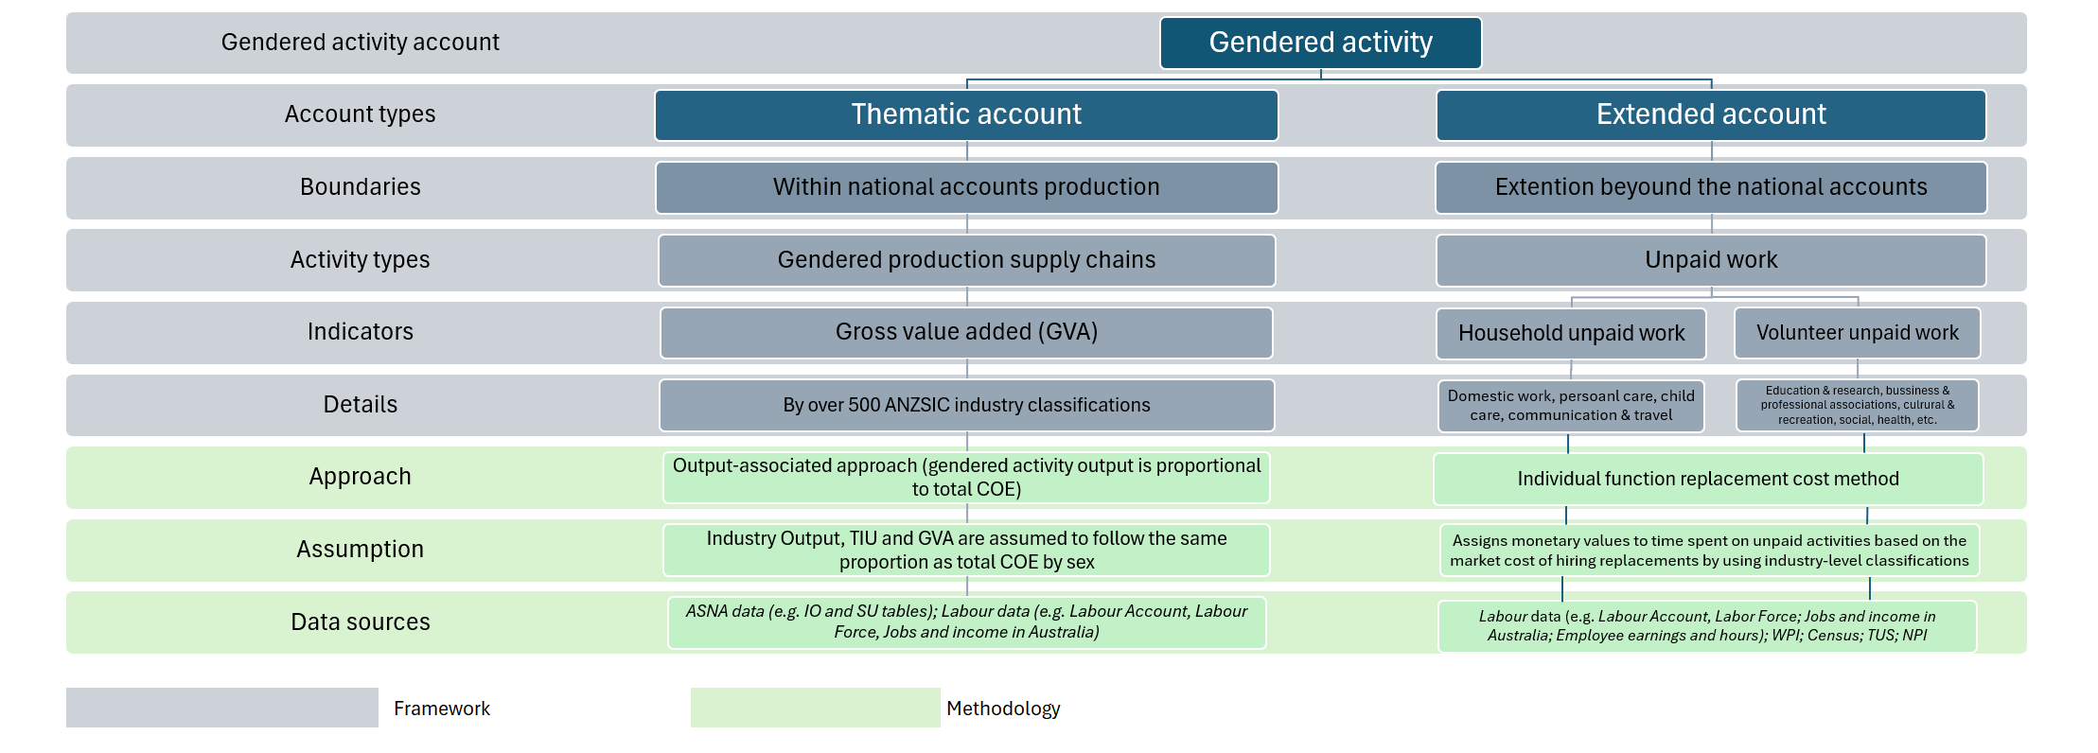
Framework and Methodology

Slide 7
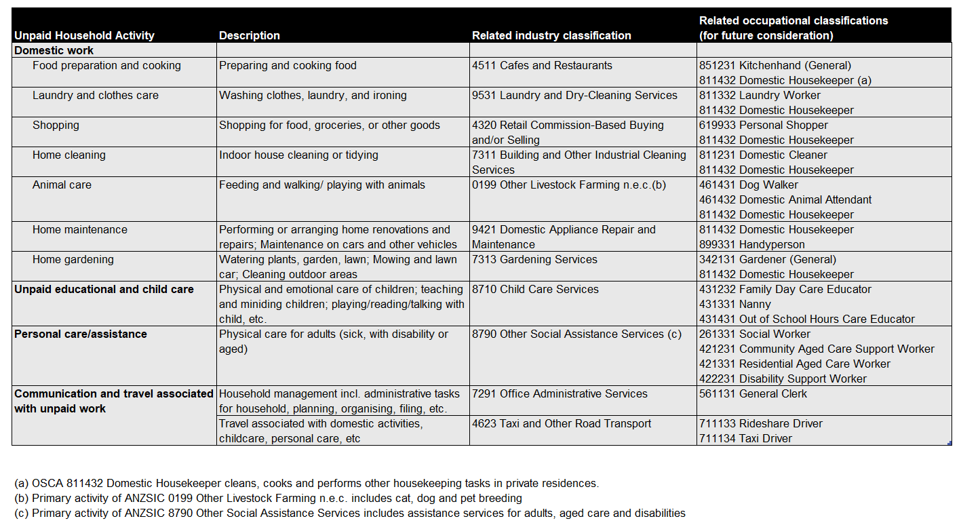
Mapping unpaid household activities with related industrial and occupational classifications

Slide 8
Key findings

Slide 9
Gendered activity summary, 1994-95 to 2023-24
Source: Source: ABS; Author’s calculations.
Total activity – including both economic and social values, contributed to nominal terms $3,940.7 billion in 2023-24.
The gross value added (GVA) contributed $2,505.1 billion, up from $455.6 billion in 1994-95;
The estimated total unpaid work rose to $1435.6 billion in 2023-24, compared to $228.4 billion in 1994-95.

Slide 10
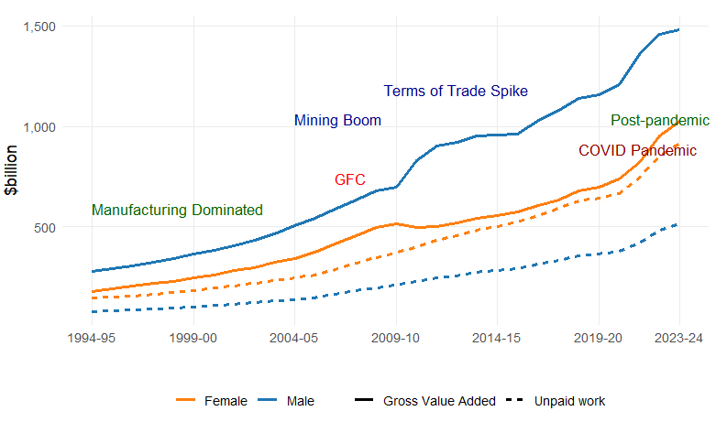
Gendered activity 1994-95 to 2023-24
Male activity contributed $1,996.5 billion (50.7%) to total gendered activity and $1,478.7 billion (59.0%) to Australia's GVA, down from 60.8% in 1994-95. Male unpaid work rose to $517.8 billion (36.1%), up from $81.0 billion (35.5%) in 1994-95.
Female activity has grown faster, narrowing the gender gap in economic contribution. Female activity contributed $1,944.2 billion (49.3%) to total gendered activity and $1,435.6 billion (41.0%) to GVA, up from 39.2% in 1994-95. Over 64% of unpaid work value has come from female activity for three decades, rising from $147.3 billion to $917.8 billion, though its share slightly decreased from 64.5% to 63.9% over the same period.
Source: Source: ABS; Author’s calculations.

Slide 11
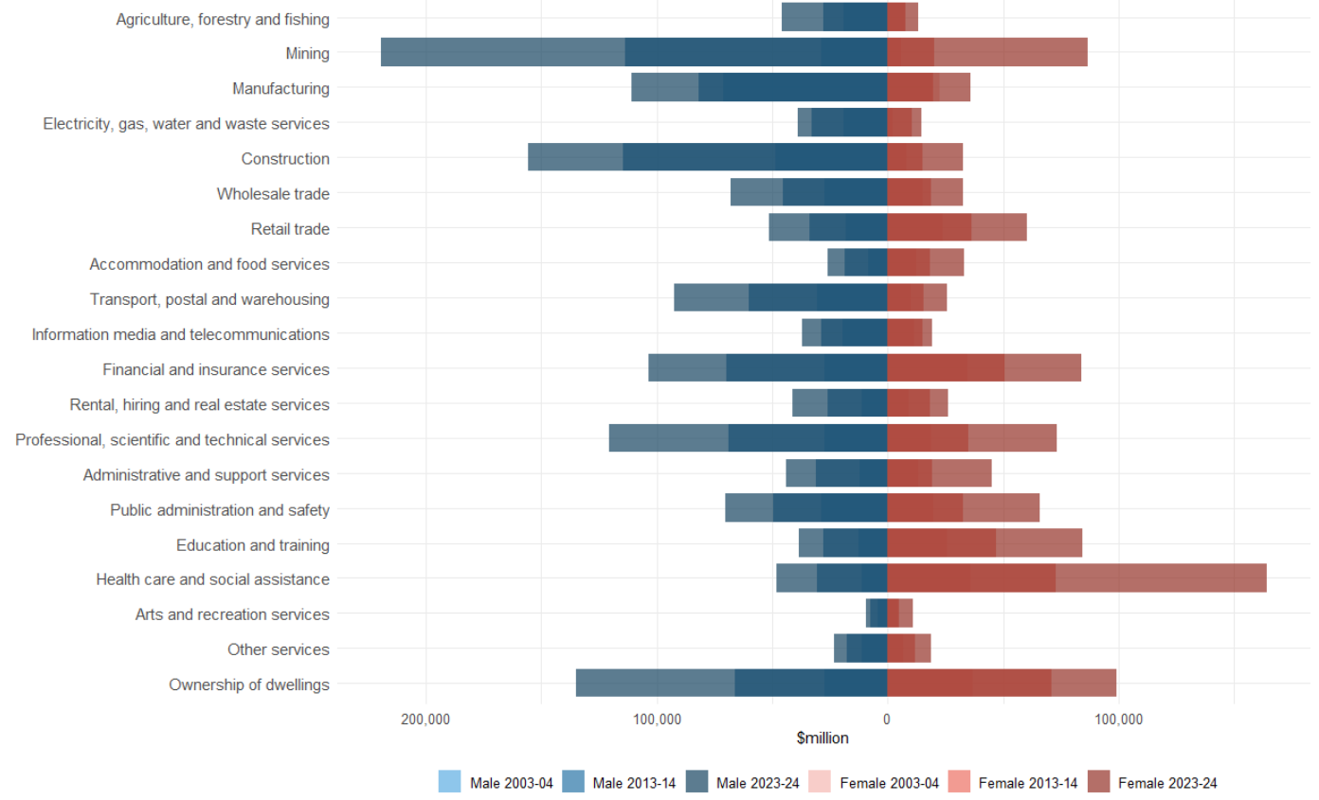
Gendered activity by industry division
1994-95 to 2003-04: Manufacturing dominated economy with gendered dynamics
2004-05 to 2013-14: The Mining boom widened the gender gap in market production
2014-15 to 2023-24: Digital expansion, pandemic, and the rise of female participation in market production
Source: Source: ABS; Author’s calculations.

Slide 12
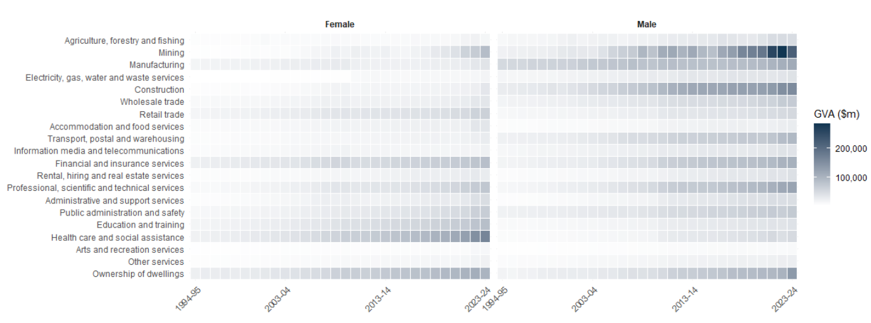
Gendered activity by industry division, 1994-95 to 2023-24
Source: Source: ABS; Author’s calculations.
Between 1994-95 and 2003-04, Australia experienced significant economic shifts, with manufacturing declining as the dominant sector. Rising female labour force participation and part-time employment drove changes in gendered contributions.
Australia’s mining boom widened gender gaps between 2004-05 and 2013-14, as male GVA rose rapidly in mining and construction, while female GVA grew modestly in health and social sectors.
There have been significant shifts in gendered economic activity over the last decade from 2014-15 to 2023-24. Male activity GVA increased by 54.6%, but its share of the economy declined from 63.2% to 59.0%, while female activity grew by 84.1%, raising its share from 36.8% to 41.0%.

Slide 13
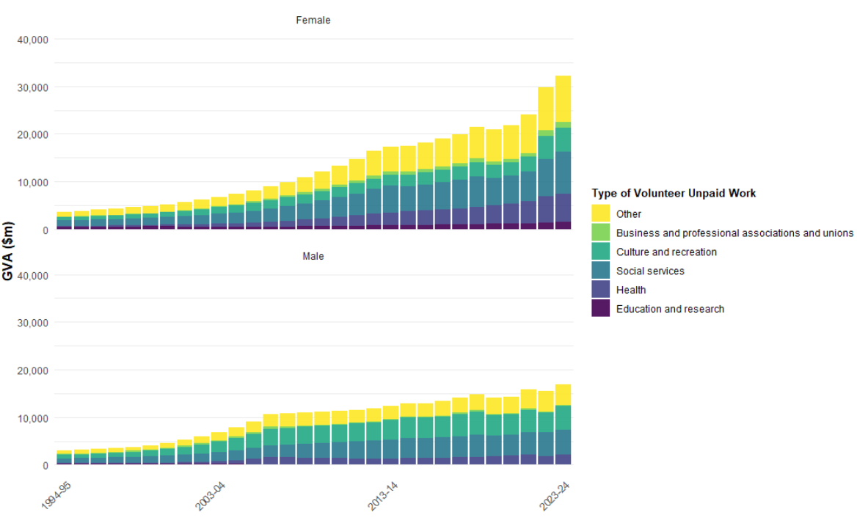
Type of volunteer unpaid work by gender, 1994-95 to 2023-24
Unpaid work continued to reflect gender disparities, though women’s contributions grew substantially more.
Over the past decade, volunteer work among women has increased significantly, while the participation rate for men has remained stable.
This stable trend potentially reflects the impact from the implementation of the National Disability Insurance Scheme (NDIS) and the expansion of Aged Care services, both of which have increased the supply for paid support and care work – roles that are traditionally and disproportionately undertaken by women voluntarily.
Source: Source: ABS; Author’s calculations.

Slide 14
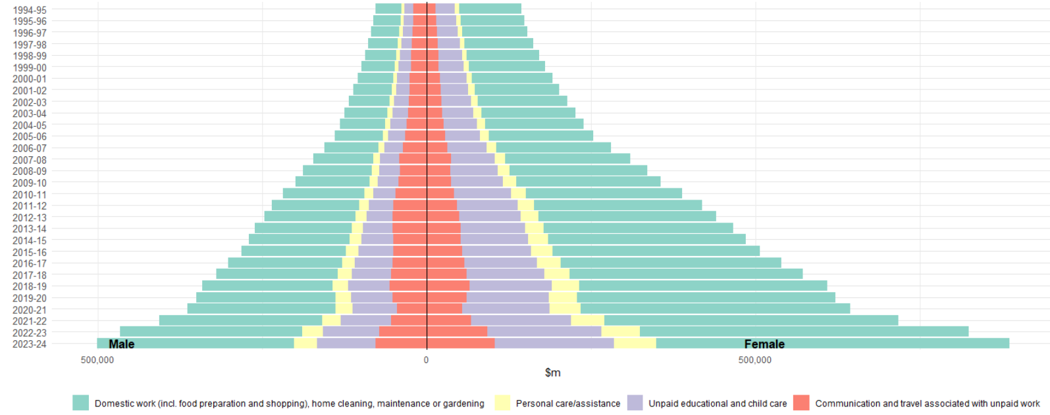
Household unpaid work by type and gender, 1994-95 to 2023-24
Source: Source: ABS; Author’s calculations.
Household unpaid work was valued at $1.4 trillion in 2023-24, up from $756.3 billion in 2014-15.
Male activity contributed $500.8 billion (36.1%) of total household unpaid work in 2023-24, representing an increase of $230.0 billion or 84.9%, from $270.9 billion (35.8%) in 2014-15.
Female activity accounted $885.6 billion (63.9%) of total household unpaid work in 2023-24, increasing by $400.1 billion or 82.4%, from $485.4 billion (64.2%) in 2014-15.

Slide 15
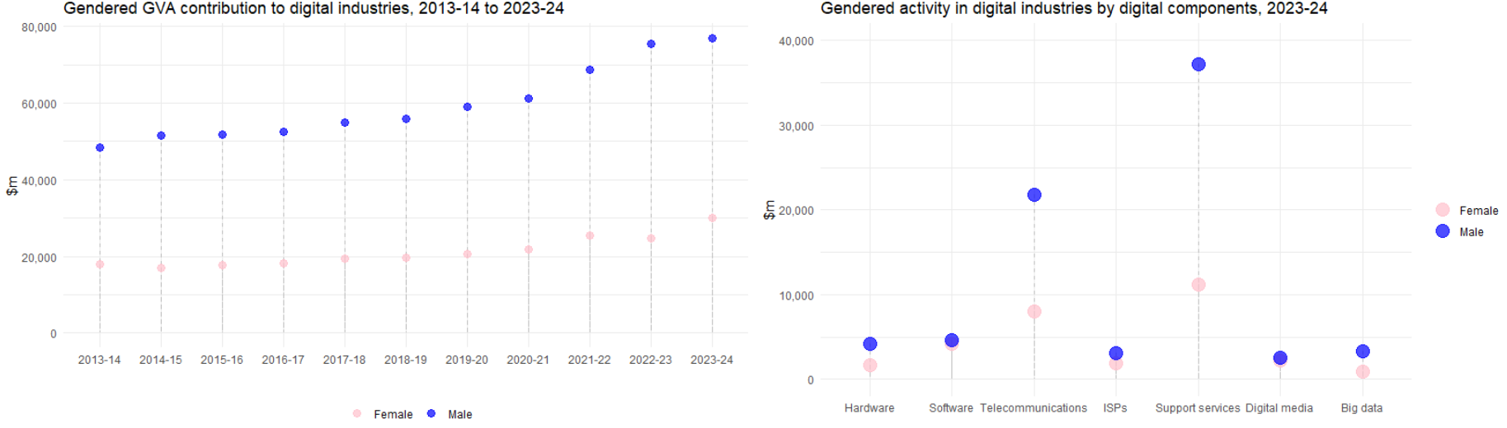
Gendered activity in digital economy industries
Source: Source: ABS; Author’s calculations.
The digital economy provides another perspective through which gender dynamics can be examined. , The male share of GVA has declined from 75% in 2014-15 to 72% in 2023-24, reflecting a gradual shift in the gender dynamics within the sector.
While the gender gap in digital industries has narrowed over the past decade, it remains significant, particularly in sub-sectors such as computer system design and telecommunications services.
Male activity continues to dominate these areas, but the increasing participation of women highlights the potential for progress. Addressing these gaps will be crucial to fostering equitable opportunities in the digital sector and ensuring that women are enabled to, and benefit from Australia’s evolving economy.

Slide 16
Conclusion and Future Study
The analysis of market production and unpaid work reveals that female economic participation has outpaced male participation, leading to a narrowing of the gender gap across various sectors, including traditionally male-dominated industries such as mining.
Despite these advancements, unpaid work, particularly for unpaid household and volunteer activities, remains a critical and underestimated value of the economy. Notably, female activity continues to account for over 60% of the total value of unpaid work, highlighting the continued gender inequity in household responsibilities.
These findings emphasise the need to address gender inequalities in both market and non-market activities to foster a more balanced and inclusive economic future. By integrating gendered activity into national accounts, policymakers can develop evidence-based strategies that promote gender equity and contribute to sustainable economic development.
Moreover, this approach lays the foundation for future research exploring the intersection of gender and thematic accounts, such as the digital economy, infrastructure, and cultural and creative activities.

Slide 17

Any Questions
Ting Li: Ting.Li@communications.gov.au
Mary Farrugia: Mary.Farrugia@health.gov.au

