Slide 1
Trade and productivity in British firms: 2005 to 2022
Kyle Jones
Economic Microdata Transformation

Slide 2
Project summary:
Department for Business and Trade (DBT) funded project between September 2024 and March 2025
Main aims:
Extend the work of Wales et al (2018) “UK trade in goods and productivity: New findings”
Incorporate information on services trade.
Extend to cover a longer time series.
Start to explore the causal link between international trade and firm productivity.
Notes:
As a quick summary of this project.
Previous work done by the ONS which developed a methodology for apportioning and linking admin data on HMRC Trade in Goods data with ONS survey data.
To start to understand the mechanisms through which international trade impacts firm-level productivity.

Slide 3
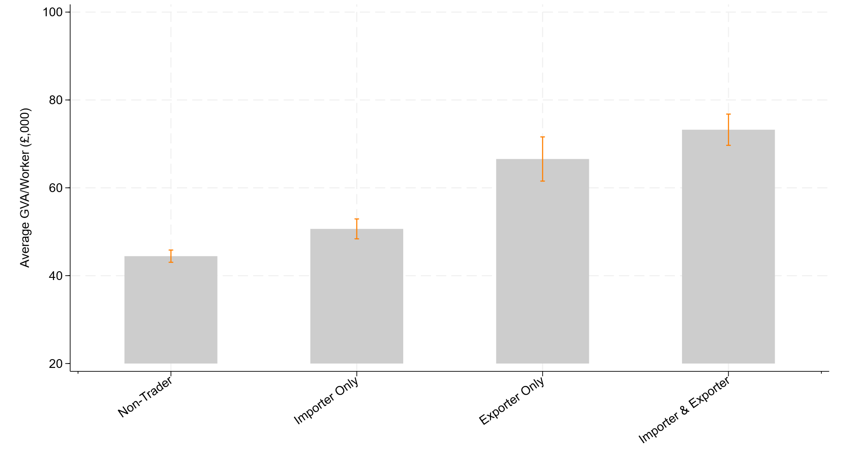
International traders are more productive than non-traders:
Figure 1: Average labour productivity by combined exporter and importer trade status, 2022, Annual Business Survey, GB:
Estimates of labour productivity in other countries have found exporters to be anywhere between 20% to 40% more productive than non-exporting counterparts (Breinlich et al (2023)).
Previous ONS research finds that goods exporters were 21% more productive than non-goods exporters between 2008 and 2016.
Notes:
Its commonly reported in existing research and across different settings that firms engaged in international trade are more productive.
In our descriptive statistics we also clearly see that firms who engage in export or import activities have higher productivity than firms with no international trade activities.
This chart shows the exact same but with using a combined export-import trade status.

Slide 4
What drives this difference in productivity across international traders and non-traders?
Is it that:
Trade makes firms more productive?
  Greater choice of intermediate inputs (Tybout about and Westbrook 1995, Kasahara and Rodrigue 2008)
  Exposure firms to new ideas via international supply chain (Crespi et al (2008), De Loecker (2004)).
Highly productive firms self-select into international trade?
  (Arnold and Hussinger (2005), Clerides et al (1998), Isgut (2001), Bernard and Jensen (1999))
Notes:
Trade makes firms more productive?
Which would capture improvements to productivity owing directly to a firm’s exposure to international markets.
For example, international markets can open firms up to greater choice of suppliers, allowing them to source cheaper or better intermediate inputs
Trade can also expose firms to new ideas through international supply chain relationships, allowing them to improve their production processes
On the other hand, there is an argument that differences are largely drive by pre-existing differences in productivity.
This might be because of these firms having a greater ability to seek out international opportunities or overcome barriers to trade.
General consensus is that both mechanisms are at play but the relative weight in different countries and settings debated. And that’s what we try to get into in this work.

Slide 5
Raw HMRC Trade in Goods (TiG) Microdata:
2005 to 2022
Linked Inter-Departmental Business Register Trade in Goods Dataset:
2005 to 2022
Novel apportionment method
(VAT Unit to Reporting Unit)
Notes:
Take raw trade-level information from HMRC TiG
Perform a novel apportionment to Industry commodity weights

Slide 6
Enterprise
VAT
PAYE
Reporting Unit
Local Unit 1
Local Unit 2
Simple business structure:
Enterprise Group
Enterprise A
Enterprise B
VAT B1
VAT B2
VAT A
PAYE A
Reporting Unit A
Local Unit 1
Local Unit 2
PAYE B
Reporting Unit B1
Reporting Unit B2
Local Unit 3
Local Unit 1
Local Unit 2
Complex business structure:

Slide 7
Linked ABS/HMRC-TiG
Samples:
Raw HMRC Trade in Goods (TiG) Microdata:
2005 to 2022
Linked Inter-Departmental Business Register Trade in Goods Dataset:
2005 to 2022
Annual Business Survey (ABS):
1996 to 2022
ABS
(2011 to 2022)
Novel apportionment method
(VAT Unit to Reporting Unit)
ABS/HMRC-TiG
(2005 to 2022)
Trade in Goods Status
Trade in Goods Value (£)
Product Mix
Country Mix
Trade in Goods Status (Post 2011)
Trade in Services Status
Trade in Services Value (£)
International Trade Variables:
Productivity Variables:
Labour Productivity (Approximate Gross Value Added per worker)

Slide 8
Some general notes:
Our analysis covers the non-financial business sector only. We additionally drop private sector firms in section O (Public administration and defence; compulsory social security), section P (Education), and section Q (Human health and social work activities).
Labour productivity = approximate gross value added (aGVA) divided by the number of workers in the firm.
We trim outliers in terms of labour productivity at the year-industry division level.
We deflate labour productivity using the UK’s balanced supply and use estimates.
We weight to the business population using firm-weights (from the ABS)
Standard errors are clustered at the industry-division level

Slide 9
Productivity premium of doing any international trade:
Table 1: Productivity premium of international traders in the ABS and ABS /HMRC-TiG data, controlling for observable firm characteristics
 | (1) | (2) | (3)
VARIABLES | Log of labour productivity
 | Average | Between Firms | Within Firm
 | ABS (2011-2022) | ABS (2011-2022) | ABS (2011-2022)
Participating in any trade | 41.6% *** | 35.4% *** | 6.7% ***
 | (0.0050) | (0.0360) | (0.0138)
Observations | 385,615 | 385,593 | 216,868
R-squared | 0.012 | 0.138 | 0.856
Region FE | No | Yes | Yes
Ind x Year FE | No | Yes | Yes
Firm FE | N0 | No | Yes
Note(s): Standard errors are given in parentheses and are clustered at the industry division level (2-digit industry). Stars correspond to p-values of *** p<0.01, **p<0.05, *p<0.1.
Notes:
Here we are trying to more accurately document the size of the trade-productivity premium in the UK.
Column 1 has no controls so essentially reflects the average difference in productivity between a firm doing any international trade (export or import of goods and/or services) and a non-trader.
In Column 2 we are regressing labour productivity (in real terms) on a dummy indicating any international trade (export or import of goods and/or services)
Whilst controlling for firm size, foreign ownership, age, region and industry by year differences in productivity.
This gives a us a between firm productivity premium. In the ABS we estimate this at 35%
In columns 3 we look to estimate a within firm productivity premium (so what is the the average productivity "uplift" a given firm experiences when it switches from not trading to trading.)
To do this, we introduce firm-fixed effects which aims to control for any other unchanging characteristics of the firm that cannot be directly observed.
In the ABS we measure this as 6.7%. so that is the average productivity "uplift" a given firm experiences when it switches from not trading to trading

Slide 10
Productivity premium of doing any international trade:
Table 1: Productivity premium of international traders in the ABS and ABS /HMRC-TiG data, controlling for observable firm characteristics
 | (1) | (2) | (3) | (4)
VARIABLES | Log of labour productivity
 | Between Firms |  | Within Firm
 | ABS (2011-2022) | ABS/HMRC-TiG (2005-2022) | ABS (2011-2022) | ABS/HMRC-TiG (2005-2022)
Participating in any trade | 0.354*** | 0.470*** | 0.067*** | 0.098***
 | (0.0360) | (0.0411) | (0.0138) | (0.0209)
Observations | 385,593 | 662,863 | 216,868 | 369,911
R-squared | 0.138 | 0.129 | 0.856 | 0.836
Region FE | Yes | Yes | Yes | Yes
Ind x Year FE | Yes | Yes | Yes | Yes
Firm FE | No | No | Yes | Yes
Note(s): The table presents the coefficient of a dummy equal to one if a firm participates in any form of trade (goods and/or services) regressed against GVA per worker (labour productivity) in a regression controlling for employment, foreign ownership, age and region and industry by year differences in productivity. Standard errors are given in parentheses and are clustered at the industry division level (2-digit industry). Stars correspond to p-values of *** p<0.01, **p<0.05, *p<0.1. Results are weighted by survey sample weights (firm weights). The coefficients in columns marked as "ABS" are taken from a regression where goods and services trade status are taken from the ABS. In columns marked as "ABS/HMRC TiG", services trade status is taken from the ABS and goods trade status is derived from HMRC TiG data.
Notes:
Relative to the averages presented previously, we know that controlling for firm characteristics will reduce some of this premium.
In columns 1 and 2 we are regressing labour productivity (in real terms) on a dummy indicating any international trade (export or import of goods and/or services)
Whilst controlling for firm size, foreign ownership, age, region and industry by year differences in productivity.
This essentially gives a us a between firm productivity premium. (We have already log transformed this coefficients so they can be interpreted in percentage terms.
In the ABS we estimate this at 35% and in the ABS/HMRC we estimate this at 47%
The reason for this difference (isn’t the time periods) is an upward induced reporting bias associated with reporting trade in goods with the EU via the intrastat threshold.
To be a goods trader in the ABS you have to report on a binary question of whether you export goods or services, in HMRC Trade in Goods we are reliant on whether we are able to link TIG to your firm. It is therefore very realistic that firms may export or import goods but do not appear in the TiG data due to these thresholds.
Essentially the bar that a firm has to reach to be an goods exporter is higher. (artificially increasing the productivity premium)
Firms do however no longer have to report trade with the EU via the Instrastat survey. But we make an adjustment to make consistent across the panel.
In columns 3 and 4 we look to estimate a within firm productivity premium (so what is the the average productivity "uplift" a given firm experiences when it switches from not trading to trading.)
To do this, we introduce firm-fixed effects to control for time-invariant observable characteristics, such as industry, region, but will also control for any other unchanging characteristics of the firm that cannot be directly observed.
In the ABS we measure this as 6.7% and, in the ABS,/HMRC-TiG data we estimate that 9.8%.

Slide 11
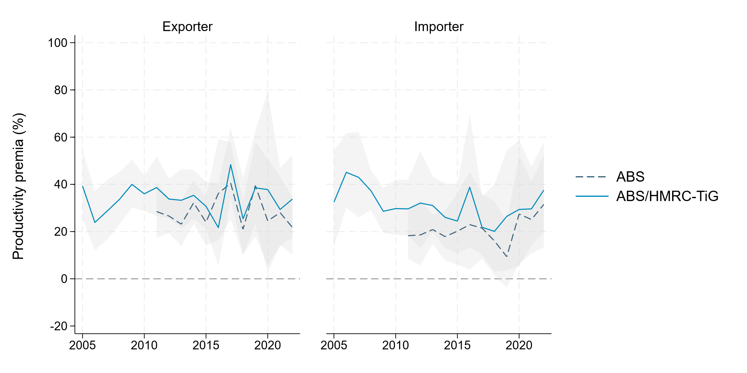
Trade-productivity premium stable through time
Figure 2: Exporter and importer productivity premium by year after controlling for observable characteristics, Great Britain, 2005 to 2022
Notes:
I wanted to quickly show this graph also:
So this repeats the specification shown in column 2 of the previous table but with
Exports and importer status separated and estimated individually by year.
This chart is useful in illustrating that the trade productivity premium (for both exporters and importers) is consistently significant and of similar magnitude.
Indicating that the trade-productivity premium is very much a characteristic of our business population rather than something that is changing through time.

Slide 12
Exploring the productivity impact of exporting goods:
Notes:
Up until now we have tried to document the size of the trade-productivity premium in the UK.
There is a lot more on this in our paper if this is of interest.
But to get into the mechanisms through which international trade impacts firm-level productivity, we need to adopt a slightly different framework.

Slide 13
Exploring the productivity impact of exporting goods:
Only looking at trade in goods
Only covering firms born after 2005 (where we can accurately determine time of first goods export)
Only look at firms who transition from non-goods exporting to goods exporting.
Reliant on the linked ABS/HMRC-TiG sample (limiting some of the scope of what we can do)
Notes:
Going to set up an Event Study:
Not looking at firms who instantly start exporting (which is something we would like to get into more)
We have very good information on the trade in goods side (time of export, export value, participation for every year) but we still rely on productivity from the ABS which is much more patchy and limits how cleanly we can track firms.

Slide 14
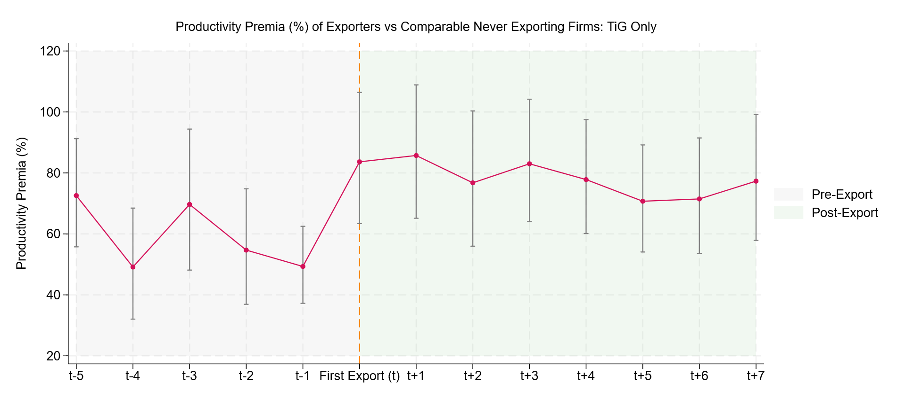
High productivity firms are more likely to export goods:
Notes:
Here we are estimating the difference in productivity between exporters and comparable firms who will never export goods.
We then estimate this individually based on the exporting firms' distance from their firm's export (again under a consistent control of firms who will never export)
Here we are controlling for our standard controls (firm-size, foreign ownership, industry, age).
From this we find that even prior to export, firms who will go onto export are about 59% more productive than comparable firms who will never export.
This suggests that high productivity firms are more likely to go on to export goods giving some weight to the argument that pre-existing differences in productivity drive observed differences in productivity across goods traders.

Slide 15
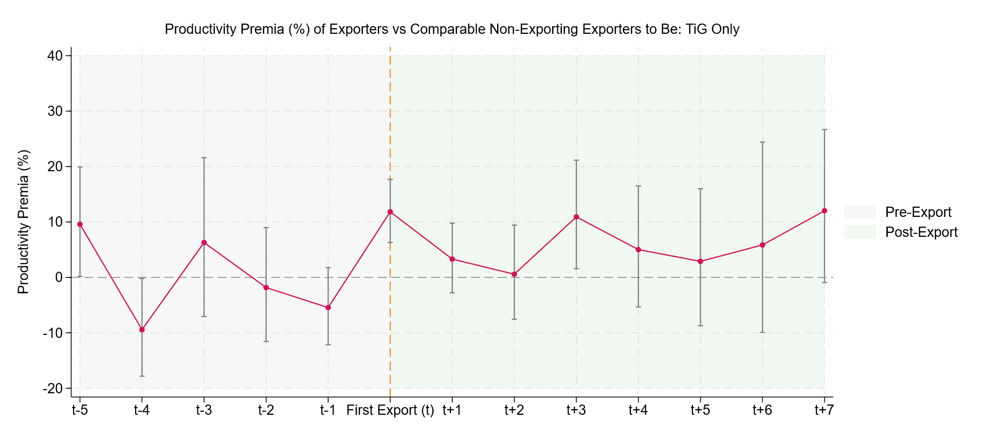
Still relative productivity gains observed following first goods export:
Notes:
From the previous output we see that firms who will export are fundamentally different from firms who will not.
We therefore repeat this exercise but only looking at firms who will export. Our treated group are exporters by their distance from first export and our control is always firms who will go on to export goods by are not yet trading. (Importantly in the pre-period the control is firms who are not the treatment groups exact distance to their first trade).
From this, we find no evidence that there are significant productivity differences between goods exporters prior to their first goods export.
But we see a relative productivity gain of 11.8% following the first year of export but evidence of this gain being sustained is weaker.
This suggests that while high productivity firms are more likely to start exporting goods, there are still productivity gains to be had following this first export.

Slide 16
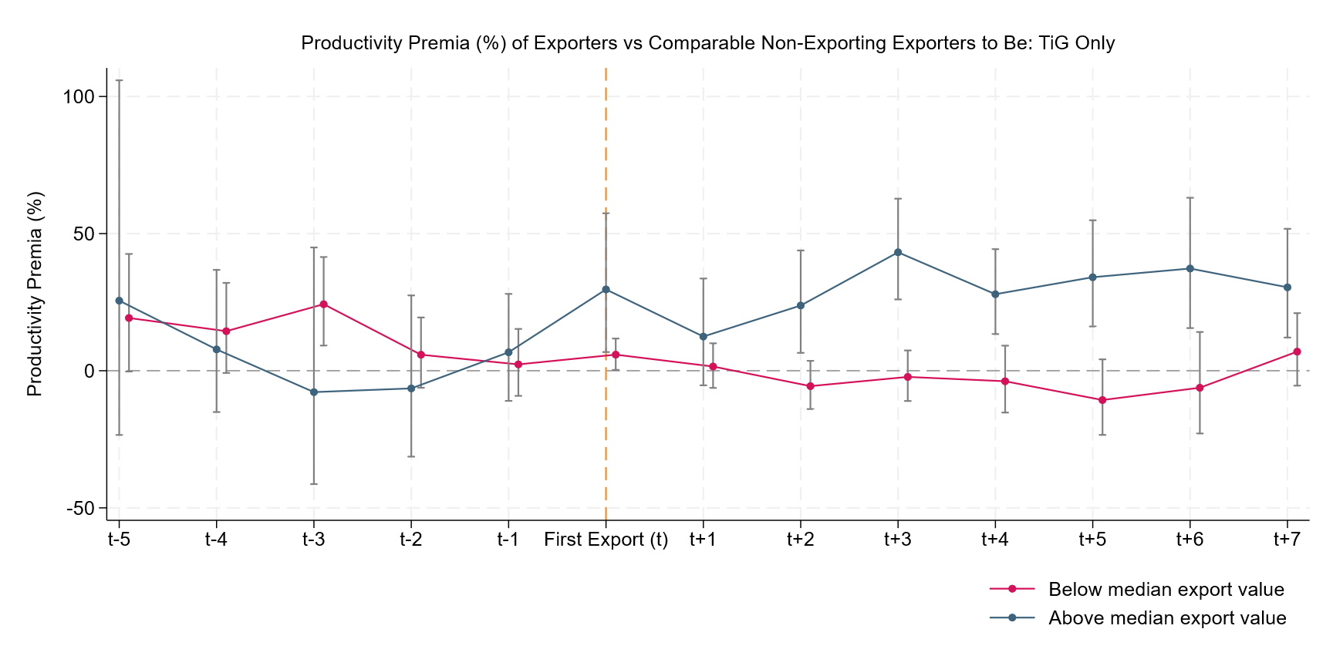
Firms that exported more had greater productivity gains:
Notes:
To unpack the average effect in the previous output we re-estimate whilst splitting out firms into whether they are predominantly above or below median exporters (in terms of export value) for their given industry.
From this we see that larger exports are driving the majority of the gains (with a higher relative increase of around 30%) additionally this gains are much more clearly sustained.
In the below median group, there appears to be little to no effect post first export.
This indicates that scale does matter and that not all small-scale export activities will result in productivity gains.

Slide 17
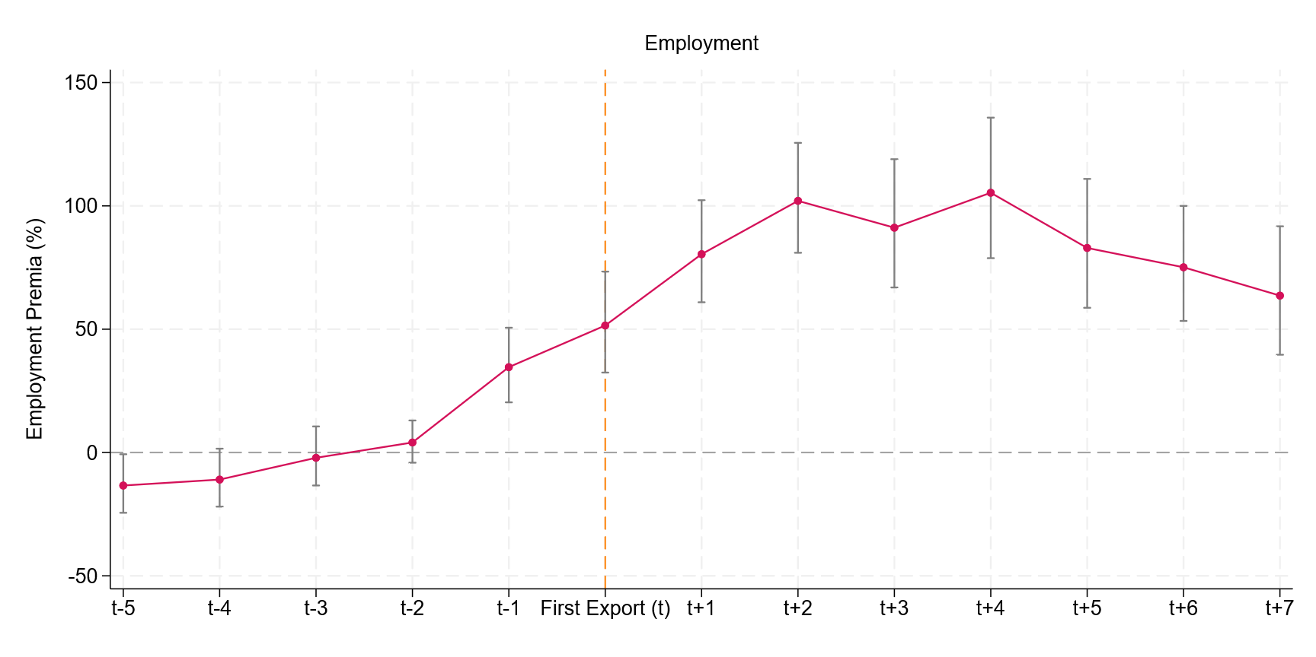
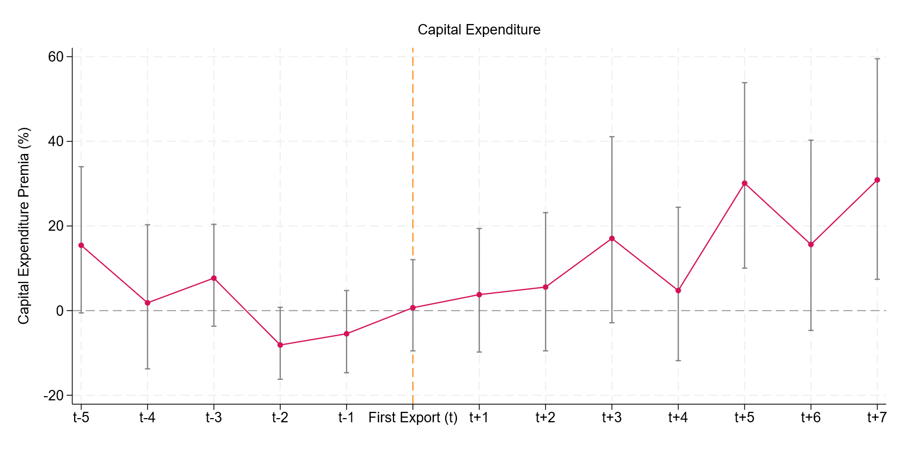
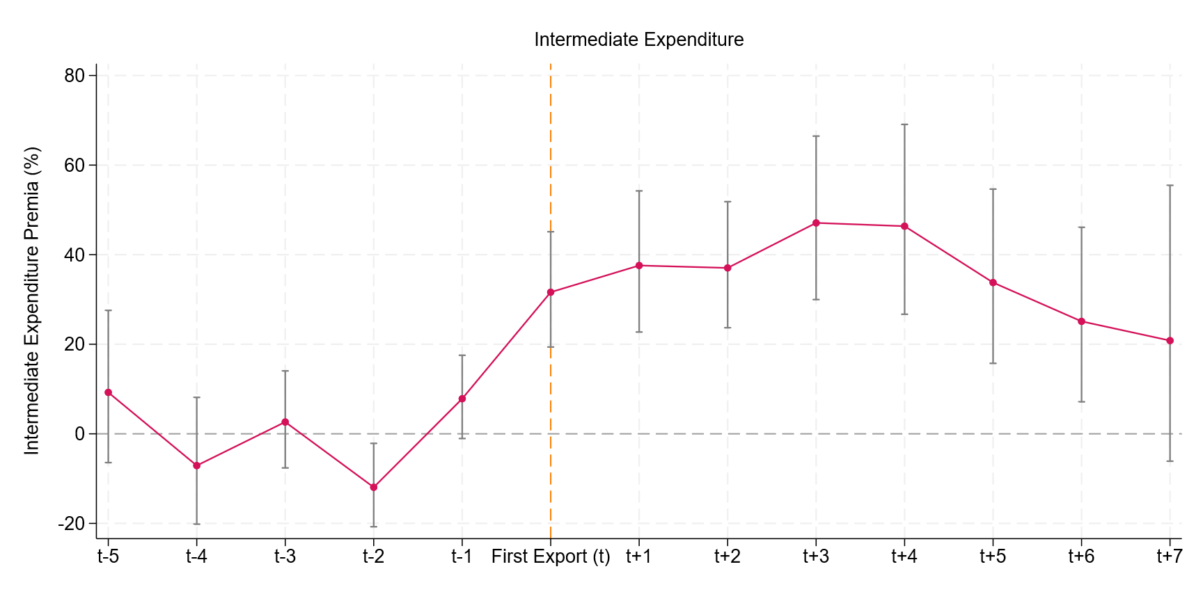
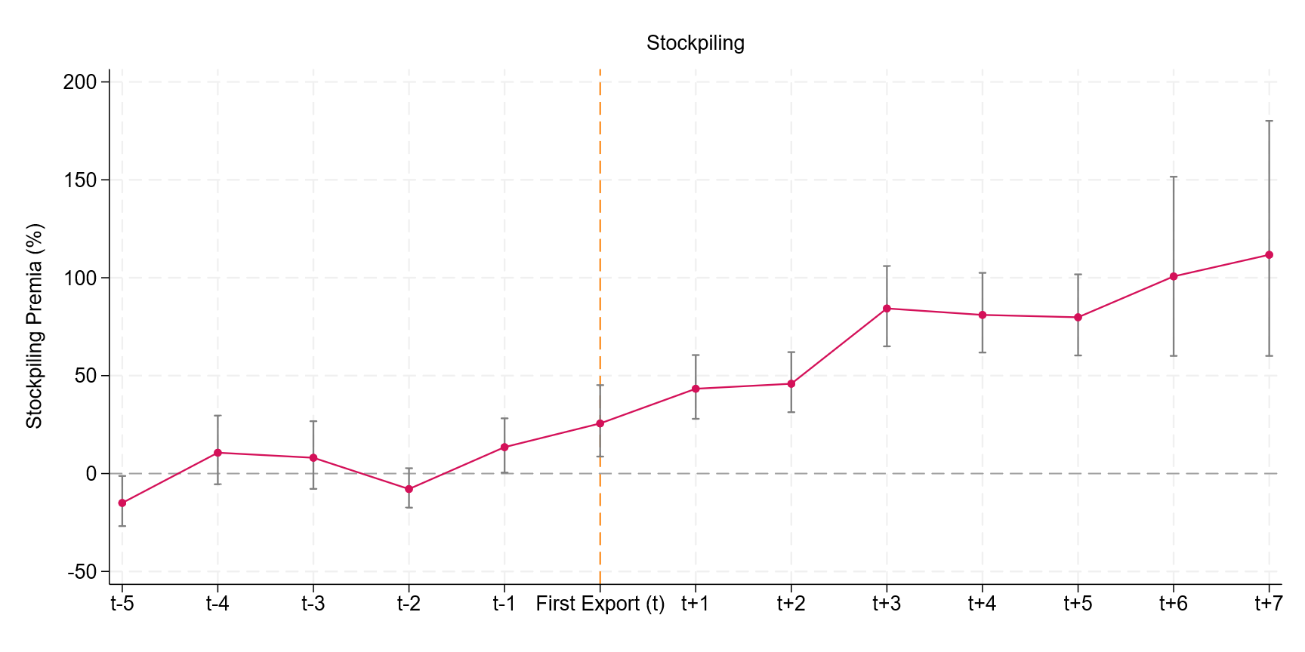
Alternative outcomes/Anticipation effects:
Differences in employment, capital expenditure, intermediate consumption and stockpiling of the treatment and control group, by time from first goods export, ABS/HMRC TiG (post 2005 sample), Great Britain
Notes:
Investigate anticipation effects.

Slide 18
Overview:
In this work, we combine administrative data on trade in goods with survey data on productivity and trade in services between 2005 and 2022 to explore the trade-productivity premium in Britain.
We estimate a trade productivity premium of doing any trade of 35.4%
We estimate a within-firm trade productivity premium of 6.7% representing the average uplift in productivity a firm receives after switching from non-trading to trading.

Slide 19
Overview: (Continued…)
For a sub-set of firms that we can track from birth between 2005 and 2022:
We find that goods exporters, before their first export, were around 59.0% more productive than comparable firms who will never export.
However, we find that firms exhibited a relative 11.8% gain in productivity in the first year following their first goods export.
Full paper: Jones and Palmou (2025) 'Trade and productivity in British firms: 2005 to 2022'

Slide 20
Extensions
Greater use of corporation tax to extend event study to full business population.
Linkage to PAYE RTI to explore the impact on workers.
Explore the intensive margin in greater detail (particularly the product and country dimension).
Notes:
Greater use of admin data will allow us to better
Impact on workers and wages will allow us to explore the productivity impacts and how they impact living standards.
What particular country or product combinations are associated with the highest productivity gains.

Slide 21
Thank you for listening
Contact: kyle.jones@ons.gov.uk

Slide 22
Appendix

Slide 23
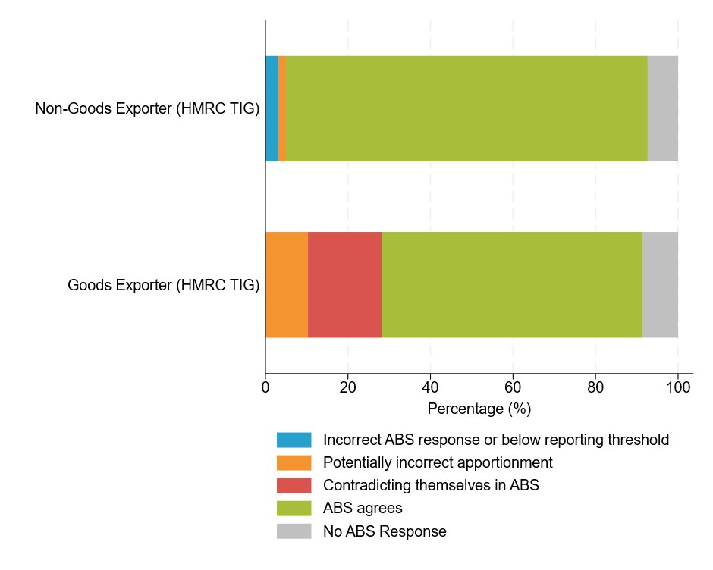
Figure A2.1 Agreement between ABS and TiG goods export status, Great Britain, 2022

Slide 24
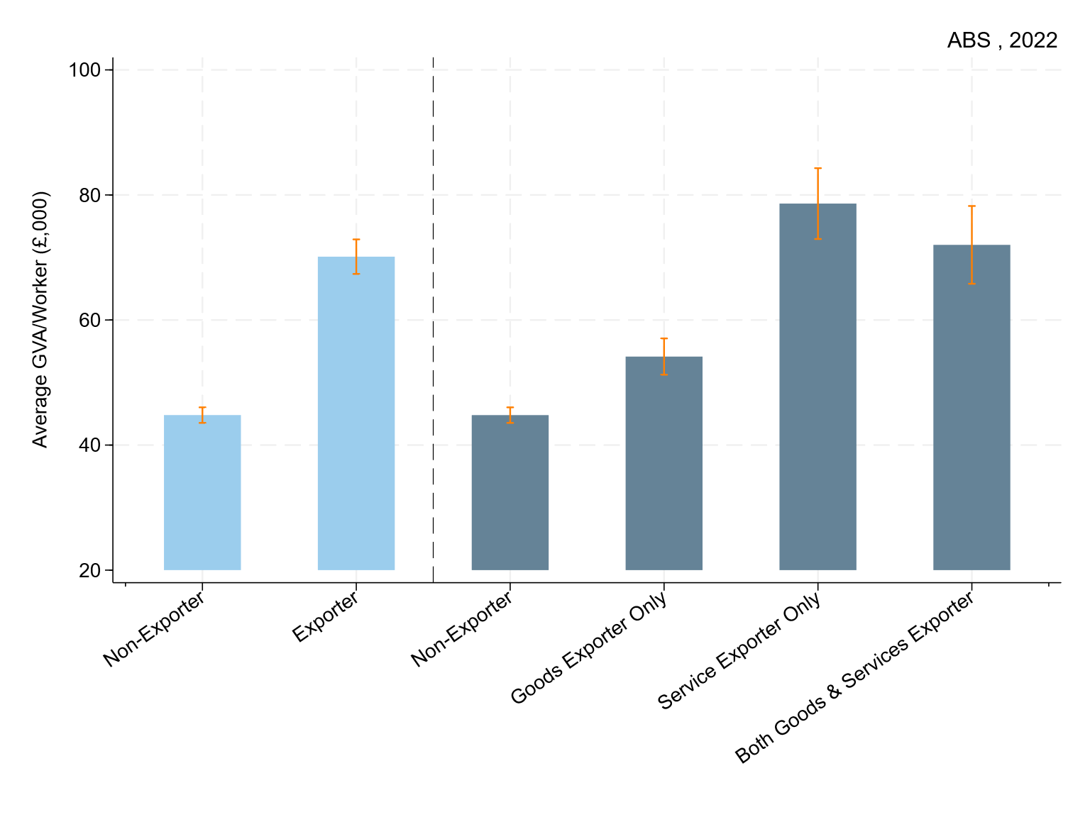
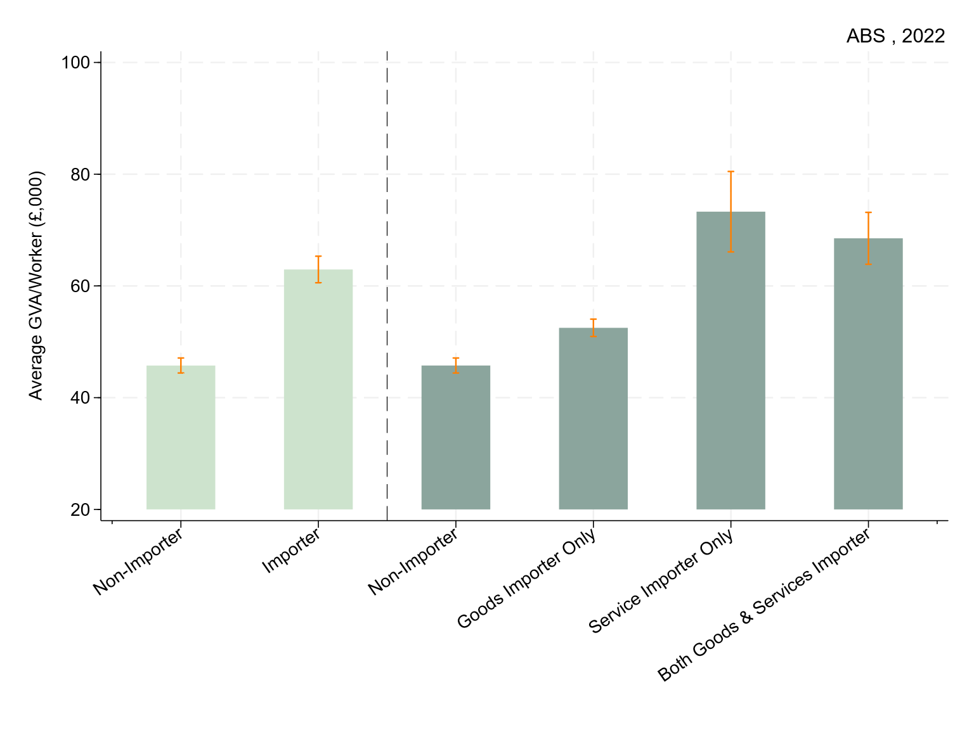
Non-Financial Business Economy, Unconditional Means, Exports and Imports:
Average labour productivity by exporter and importer type, 2022, Linked TiG-ABS, GB:
Notes:
Starting with some very quick descriptive statistics.
It is regularly observed that International traders being more productive than non-traders.
Here we show average labour productivity by exporter and importer status in the ABS, in 2022
Across both of these you can very clearly see international traders being more productive on average than non-traders.

Slide 25
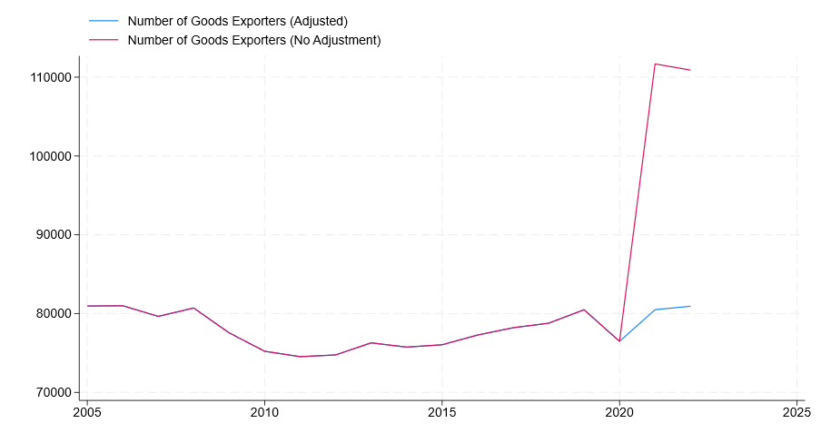
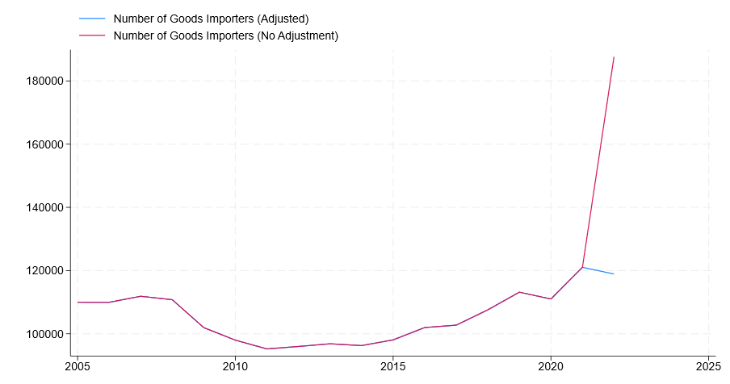
Intrastat Adjustment
In an attempt information on trade with the EU more comparable across our panel following recent changes to the collection method, we make an adjustment within the linked IDBR/Trade in Goods dataset. For exports, where a firm first declares trade with the EU in or after 2021 with an export value of less that £500,000, we set their EU export value to zero. For imports, where a firm first reports imports from the EU in or after 2022 with an import value less that £1,500,000, we set their EU import value to zero.
Figure: Number of goods exporters in linked IDBR-HMRC TiG data, with and without Instrastat adjustment, Great Britain, 2005 to 2022
Figure: Number of goods importers in linked IDBR-HMRC TiG data, with and without Instrastat adjustment, Great Britain, 2005 to 2022

Slide 26
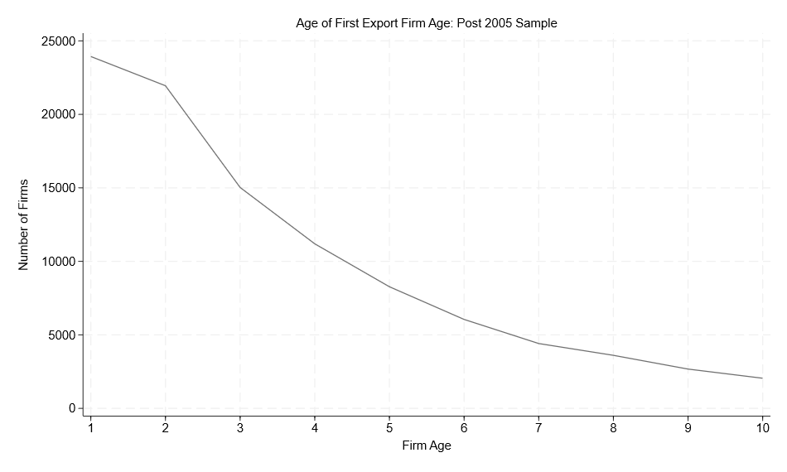
Figure B2.1: Age of First export by firm age, Post 2005 sample, Great Britain

Slide 27
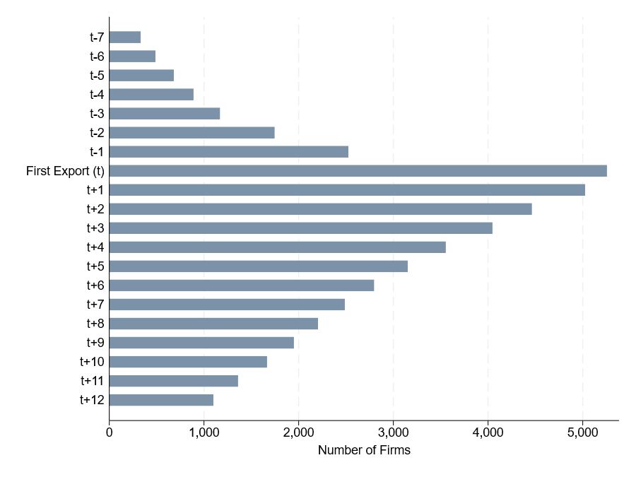
Figure C4.1 Number of Annual Business Survey responses by firm time from first goods export, post 2005 sample, Great Britain, 2005 to 2022

Slide 28
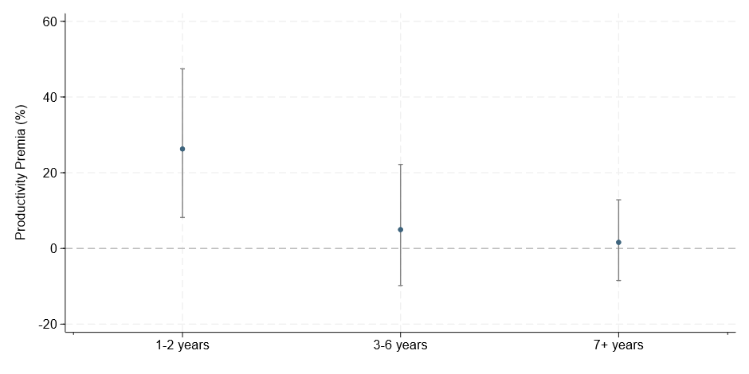
Starting early, potentially better?
Figure: Two-way fixed effects model coefficient by firm age at time of first export, post 2005 sample, Great Britain, 2005 to 2022

