Slide 1
Measuring the consumer benefits of digital technologies and AI
Avinash (Avi) Collis
Assistant Professor
Heinz College of Information Systems and Public Policy
Carnegie Mellon University
www.avinash.info

Slide 2
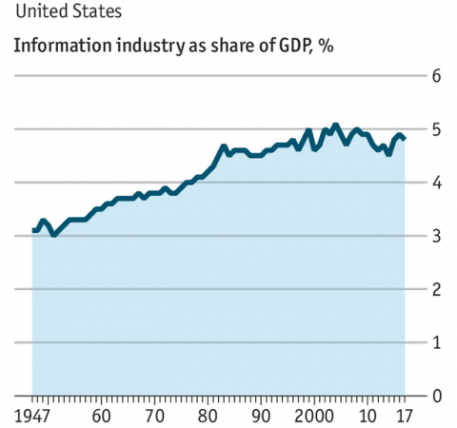
IT & GDP
Notes:
Link well to next slide

Slide 3
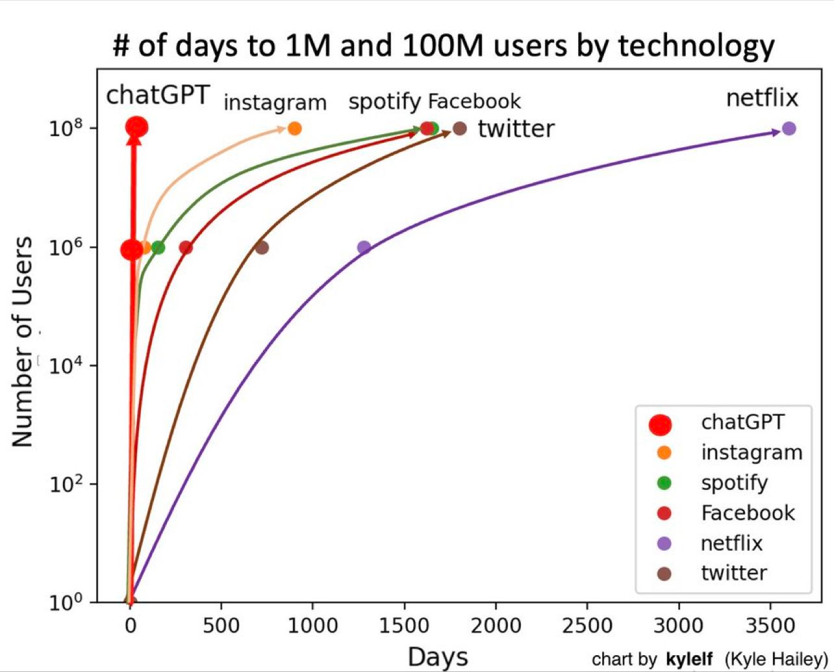
ChatGPT: two months to reach 100 million users
Today: used weekly by 10% of the world’s population! (750 million users)
- Chatterji et al. (2025)

Slide 4
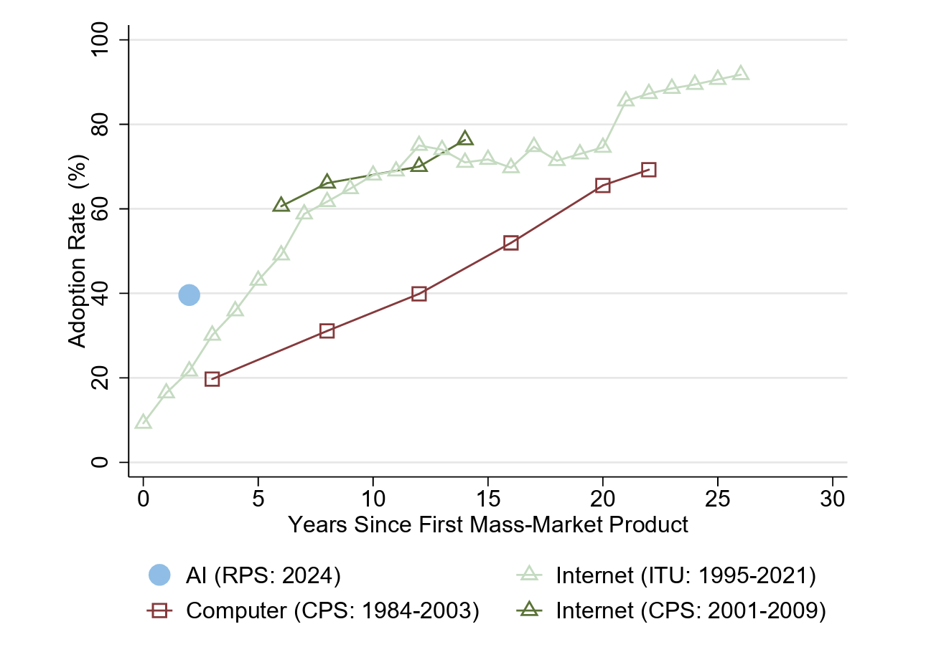
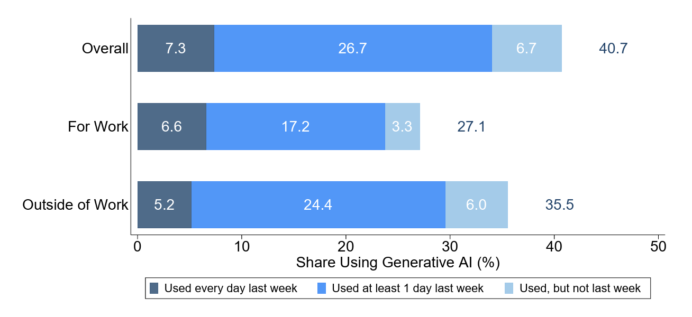
Rapid Adoption of gen AI (Bick, Blandin and Deming (2025))
40% of US adult population regularly uses gen AI

Slide 5
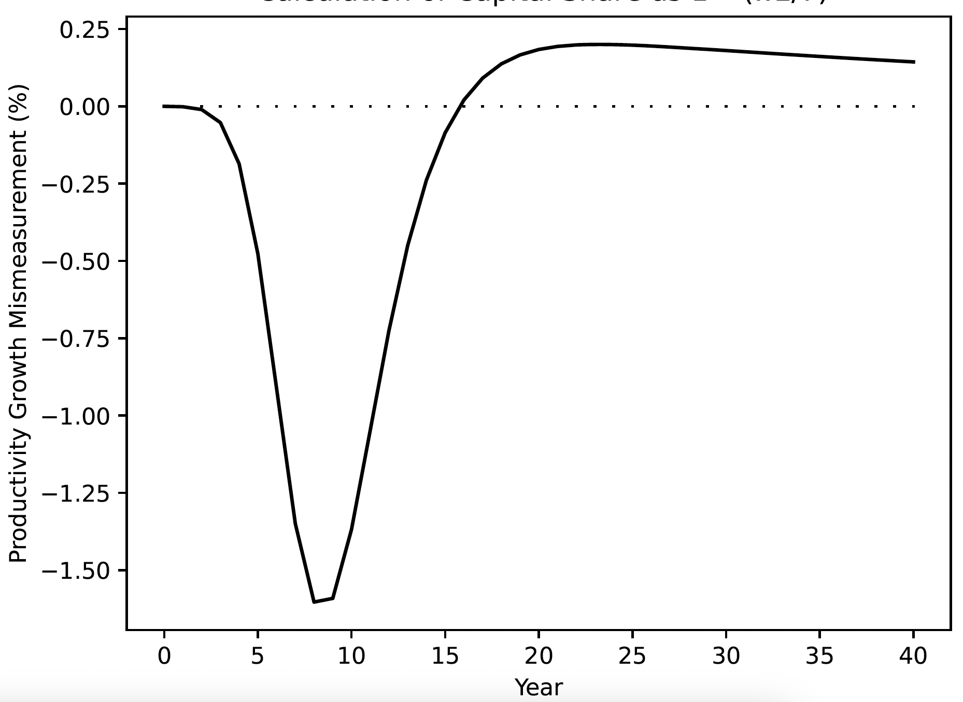
Productivity impact
Productivity benefits yet to be seen
Projections for future:
  Acemoglu: no more than a 0.71% increase in total factor productivity over 10 years (0.07 pp annually)
  Tyler Cowen: 0.5 pp annually
  Goldman Sachs: 1½pp annually
Rock, Brynjolfsson and Syverson (2021)

Slide 6
Productivity vs. benefits/ welfare
How do we reconcile the massive quick adoption with modest predictions about impacts on productivity?
Productivity/ GDP etc. measure production and are not meant to measure welfare
  They may be correlated often but the association breaks down with digital goods (zero marginal cost, often available for free to consumers)
We need to directly measure consumer welfare if we want to better understand how people are actually doing
For technological innovations, majority of welfare gains seem to go to consumers
  In the 20th century: 97% to consumers, 3% to firms (Nordhaus 2004)

Slide 7
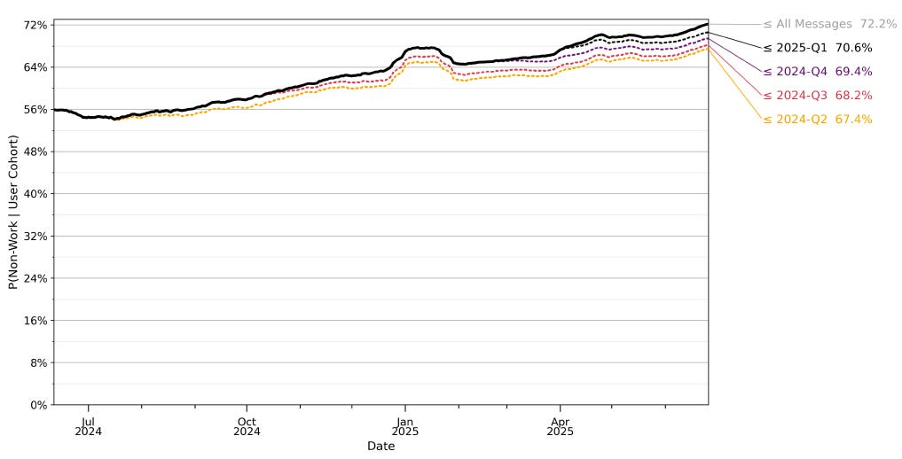
Especially important for chatGPT
Ref: Chatterjee et al. (2025)

Slide 8
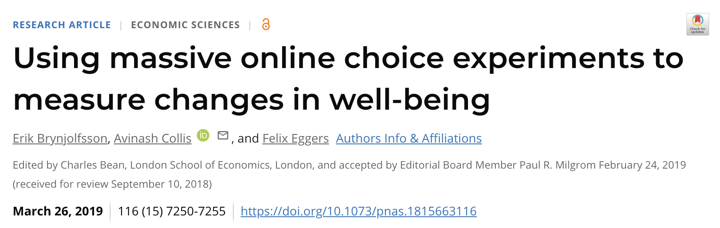

Our Approach
Estimate consumer welfare directly using large scale online choice experiments instead of inferring it from measures of production
  With incentive compatibility
    Incentive-compatible design mitigates concerns of hypothetical bias

Slide 9
Single Binary Discrete Choice (SBDC) Experiments
Ask consumers to make a single choice among two options:
Keeping the good
Give up the good and receive $W in return
Prices $W randomized across consumers
  Aggregation of data leads to demand curves
Can be done with an incentive compatible design
    Important to avoid hypothetical bias
      For FB, incentive compatible valuations are 3.5X hypothetical valuations

Slide 10
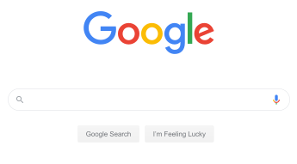

Best-Worst Scaling: Relative valuations
Choose the most valuable and least valuable option from a list of items (Louviere, 1987)
Relative valuations of different goods
  Can include all types of goods including those for which incentive compatible design is difficult
  Doesn’t suffer from hypothetical bias
Balanced incomplete block design to ensure all pairs of goods are evaluated together sufficiently
  Each user answers 3 randomly selected questions
vs.

Slide 11
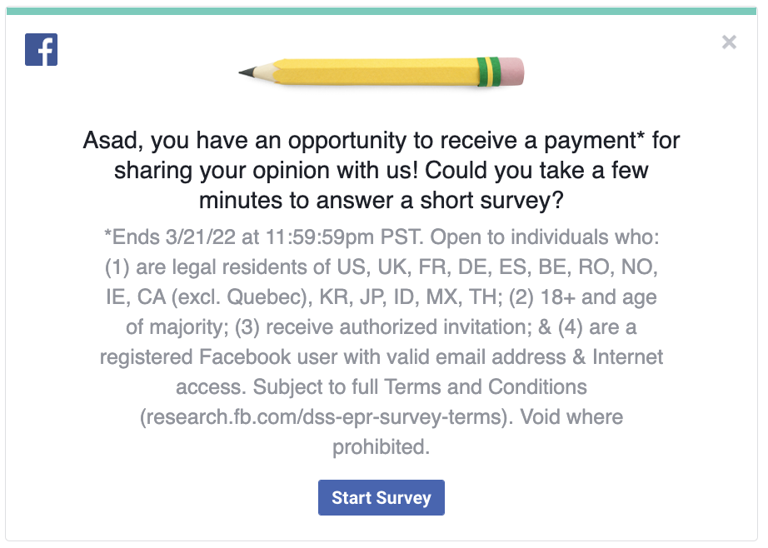
Platform for choice experiments
Online survey panels
In-person lab experiments
Direct partnership with platforms (e.g. Meta)
  Allows us to do very large-scale representative studies internationally with strong incentive compatibility

Slide 12
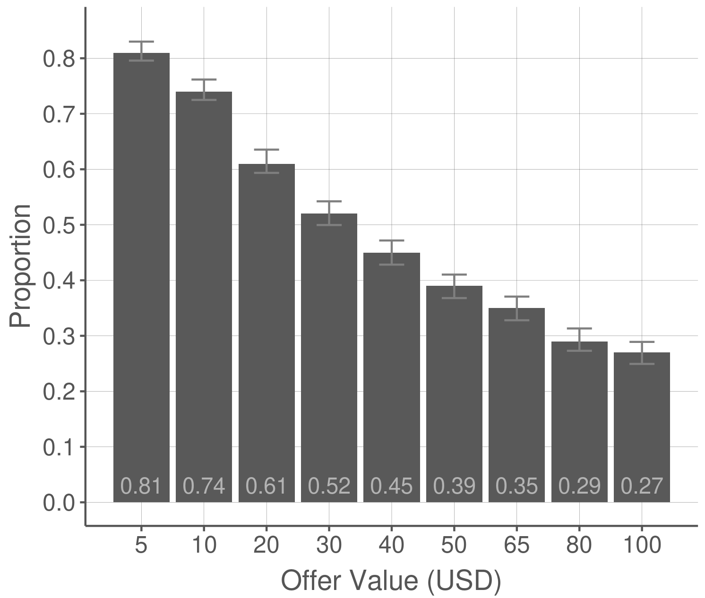
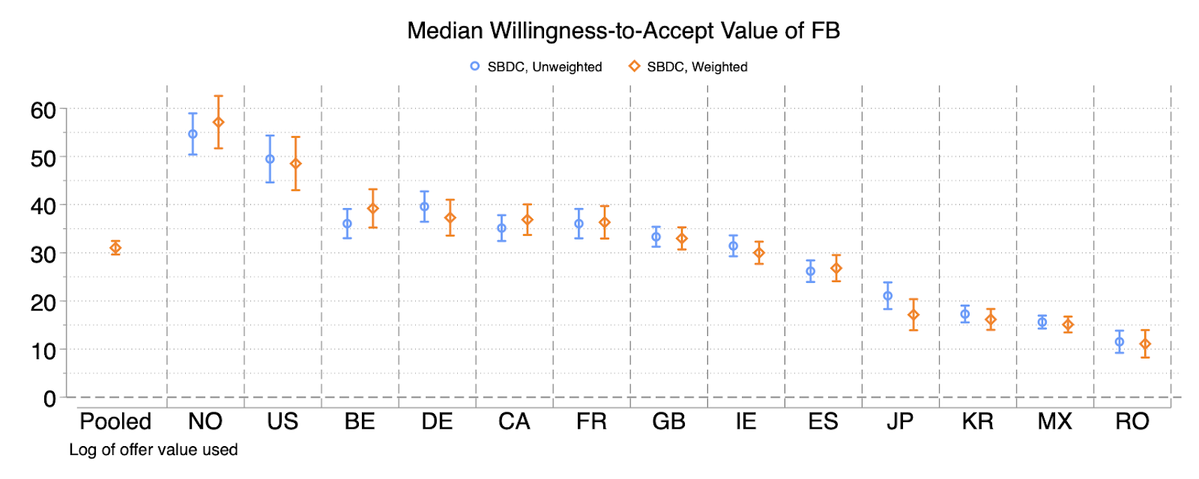
Facebook valuation using SBDC experiments
19% have a valuation < $5 to give up Facebook for a month, 24% have a valuation > $100
Demand curve estimated using weighted logit model
Overall median monthly valuation across 13 countries: $31
  Min. $11 in Romania, Max. $57 in Norway

Slide 13
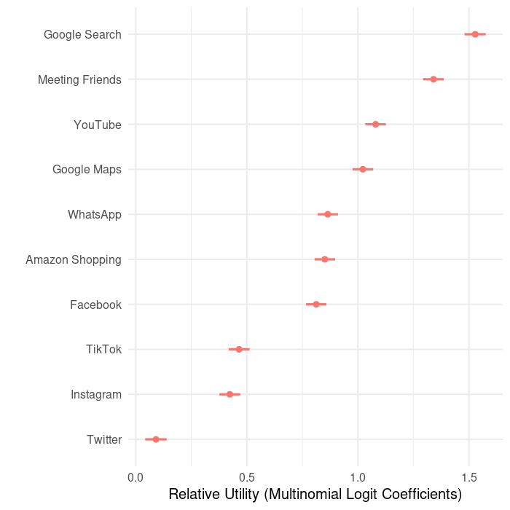
Which digital goods are the most valuable?
Relative valuations (2022)

Slide 14
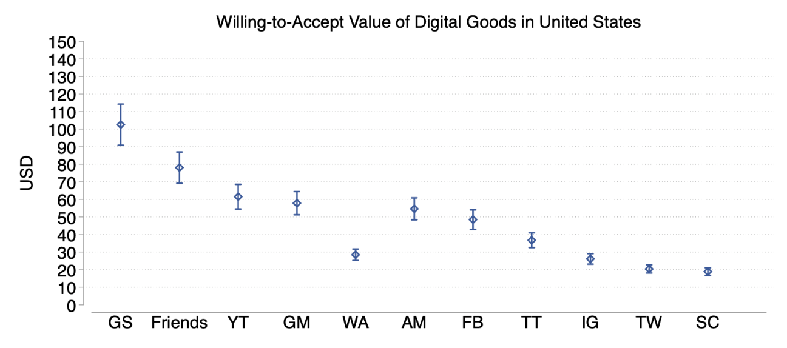
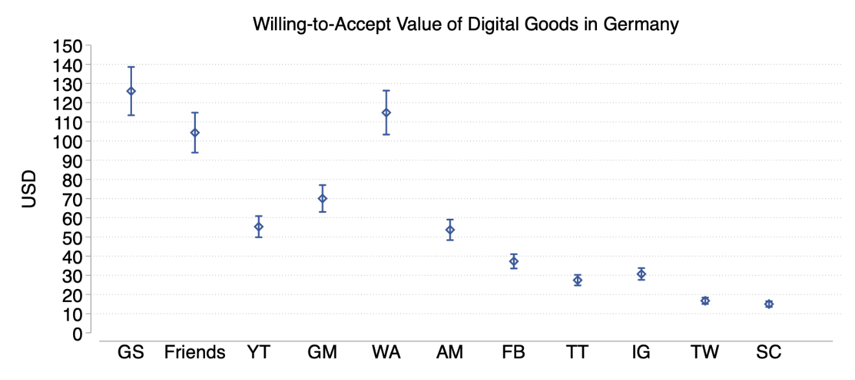
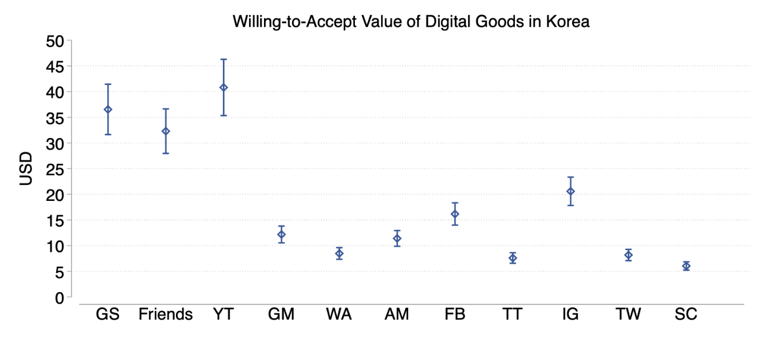
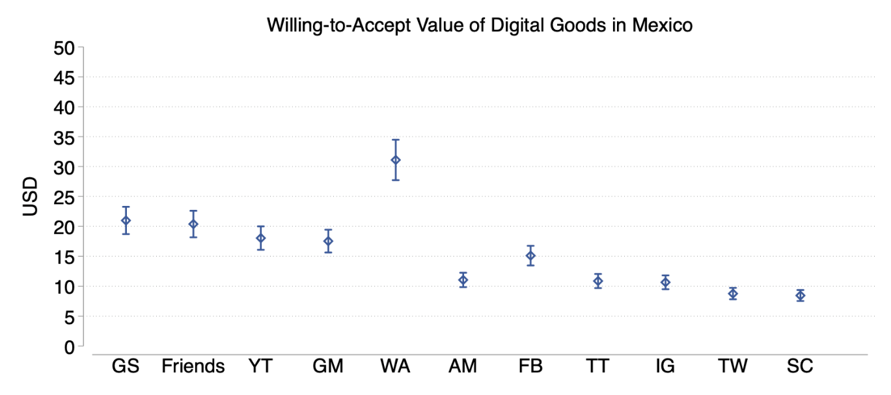
Valuations of digital goods across countries

Slide 15
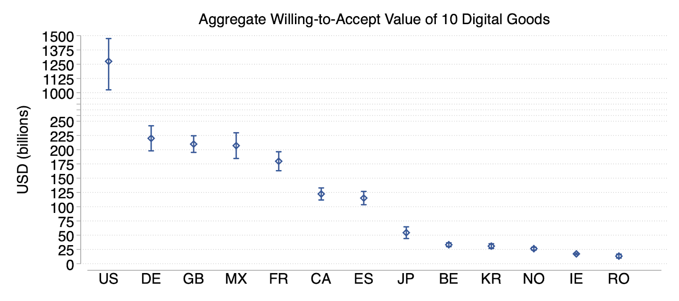
Welfare gains from digital goods across countries
These 10 digital goods generate a total of $2.5 trillion in welfare across these countries
  Ranging from $13 billion in Romania to $1.29 trillion in US

Slide 16
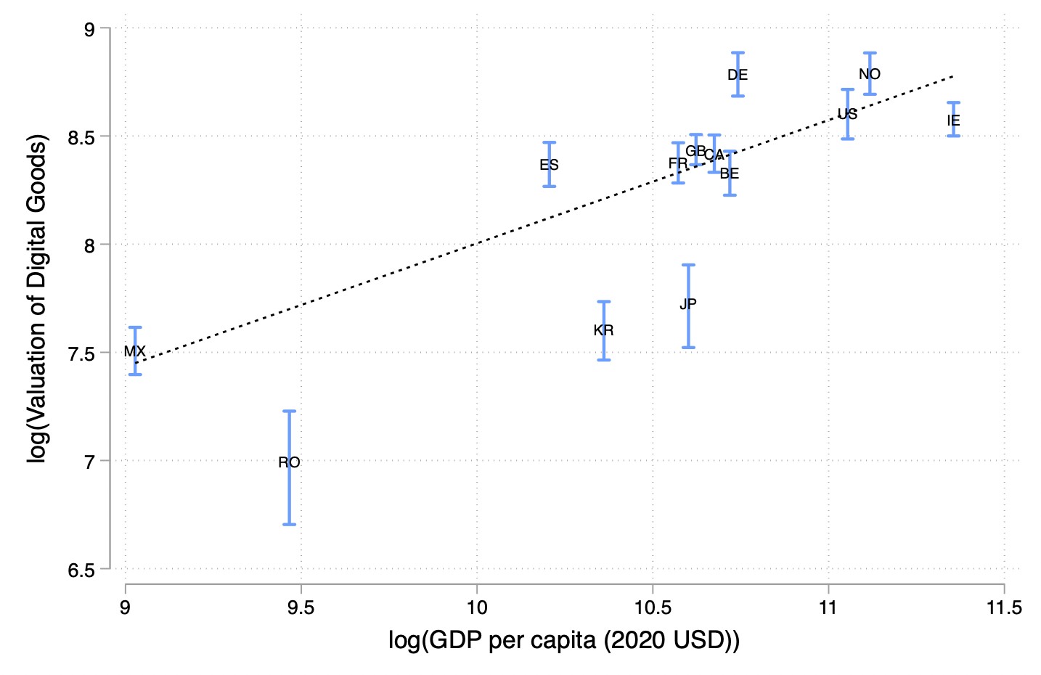
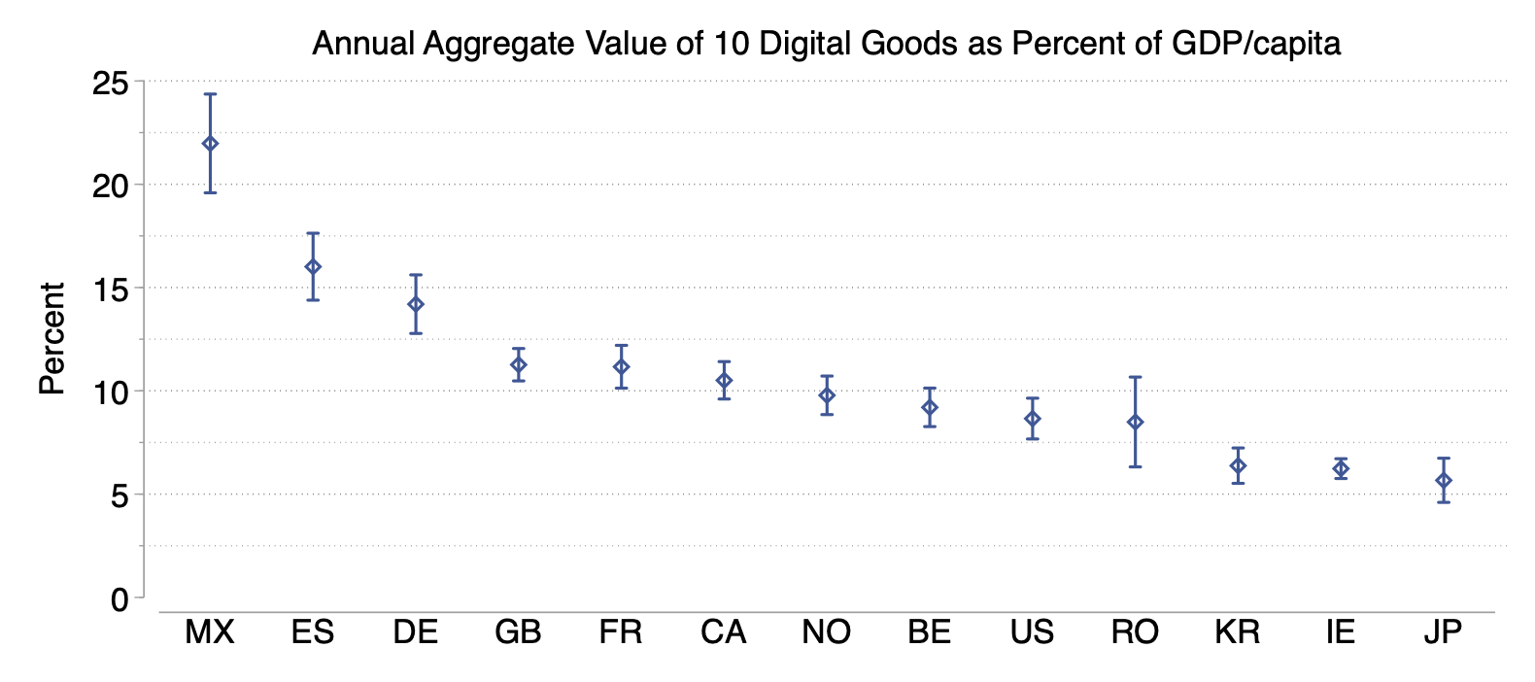
Welfare gains as a % of GDP
Takeaway: Digitization reduces welfare inequality across countries.
A 1% increase in a country’s GDP per capita is associated with a 0.68% increase in users’ valuation of the 10 digital goods relative to GDP per capita.
(β = 0.68, p-value = 0.002).
Notes:
45 degrees line

Slide 17
Welfare gains within countries
Heterogeneity in welfare gains by wealth levels within each country
Relative wealth index (RWI): Chi et al. (2021)
  Relative wealth of an area at 2.4 km resolution
    Estimates are built by applying ML algos to data from satellites, mobile phone networks, and topographic maps, as well as aggregated and deidentified connectivity data from Facebook.
      Trained and calibrated using nationally representative household survey data from 56 countries and then validated using household survey data from 18 countries.
Also heterogeneity based on self reported education, home ownership, gender
  correlated with wealth

Slide 18
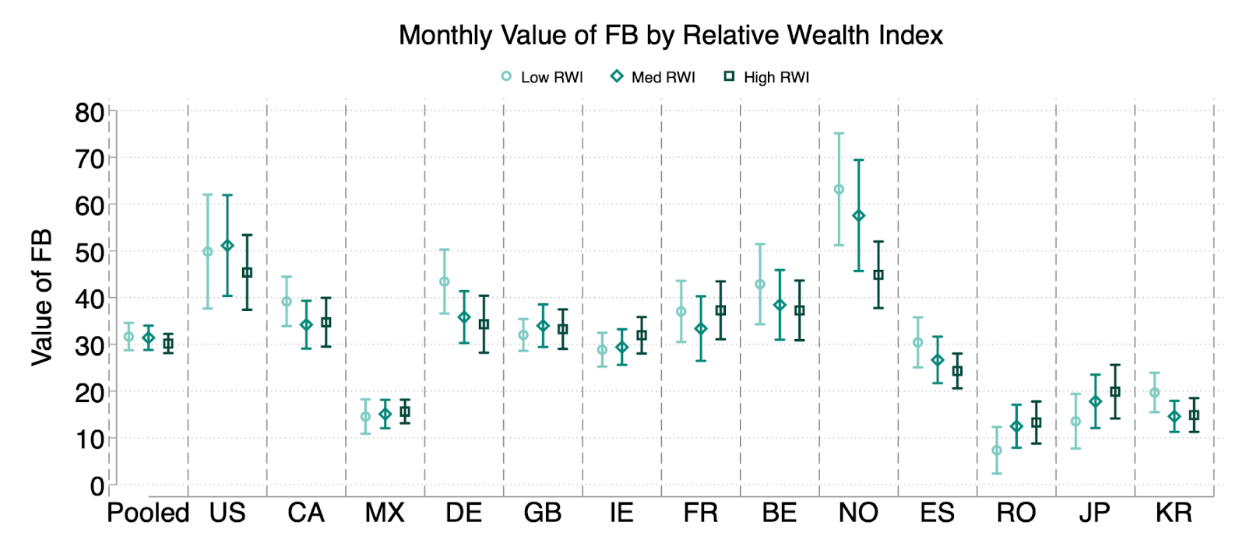
Welfare gains within countries
Facebook valuations do not vary by indicators of material wealth

Slide 19
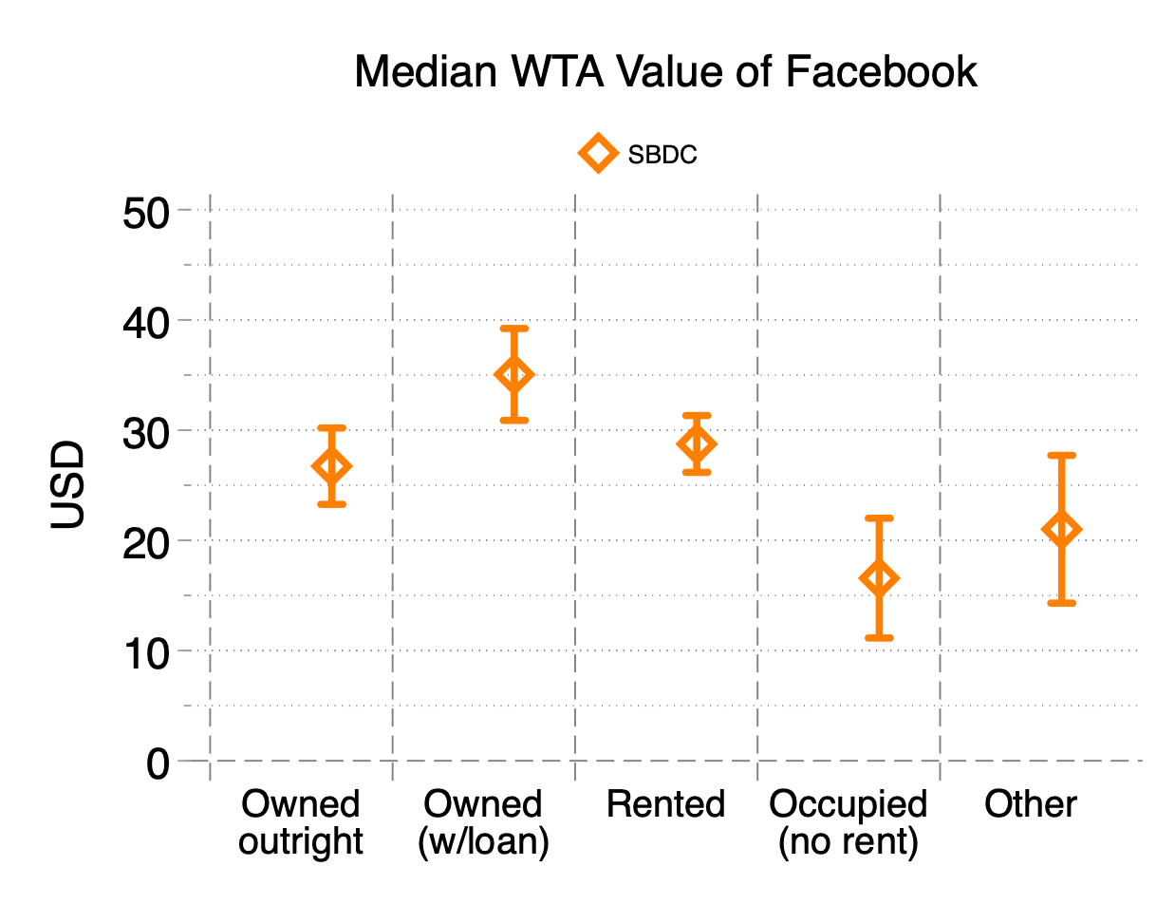
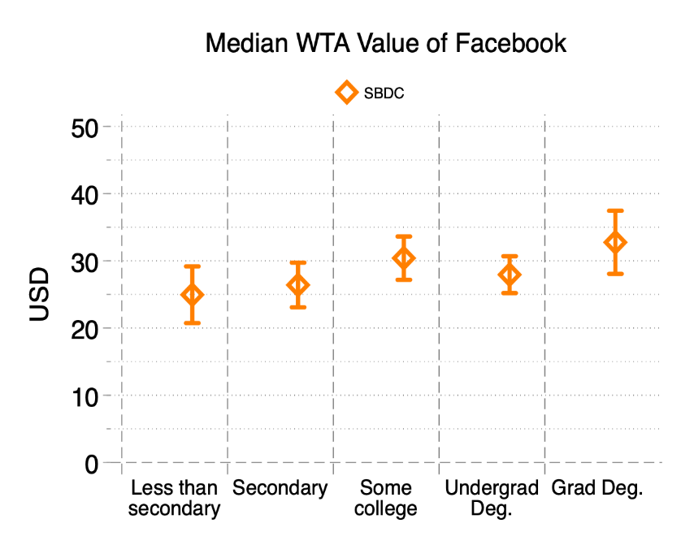
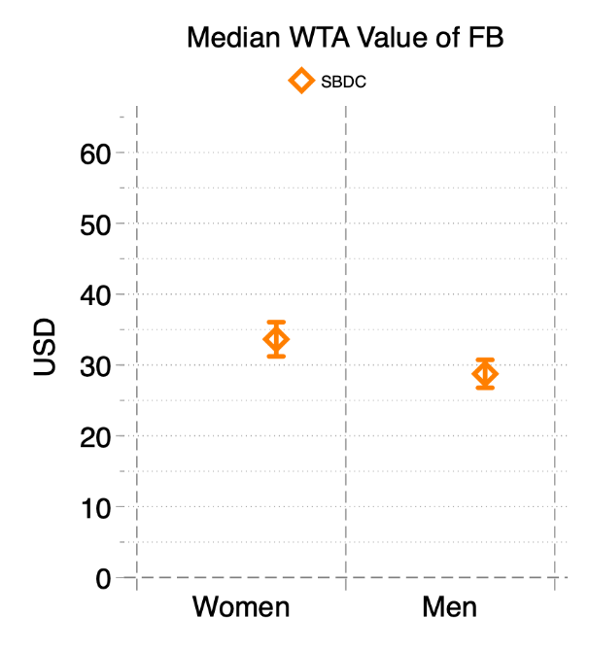
Welfare gains within countries
Homeownership
Education
Gender

Slide 20
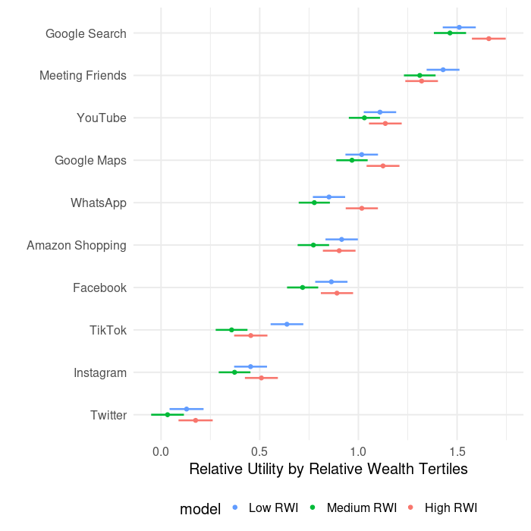
Welfare gains within countries
No systematic association between wealth and valuations
  Differences rarely significant across terciles -> lower RWI users benefit more
  Poorest and wealthiest users have greater value for most digital goods
  In some cases (Google Search), users in top tercile derive highest welfare
  In some other cases (TikTok), users in lowest tercile derive highest welfare

Slide 21
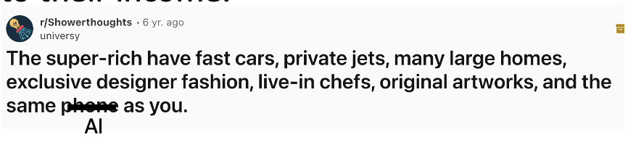
Digitization and welfare inequality
Takeaway: Welfare gains from digital goods disproportionately benefit lower-income countries and individuals
Free digital goods are available to both higher and lower-income individuals and at the same quality
  A billionaire has access to the same quality search engine or messaging app or AI chatbot as the average person
  Lower-income individuals are expected to consume higher quantities of free digital goods because they have less money to spend on other goods, and also because their opportunity cost of time is lower
Notes:
Transition well to next slide

Slide 22
Consumer welfare vs. time spent vs. ad revenue
Do our estimates of consumer surplus capture additional information beyond measures of time spent and advertising revenues?
  Valuing digital goods using time spent: Goolsbee and Klenow (2006)
  Valuing digital goods using advertising revenues: Nakamura et al. (2017)
Compare Facebook valuations with administrative data on:
  Time spent on Facebook
  Advertising revenues from each user in our study

Slide 23
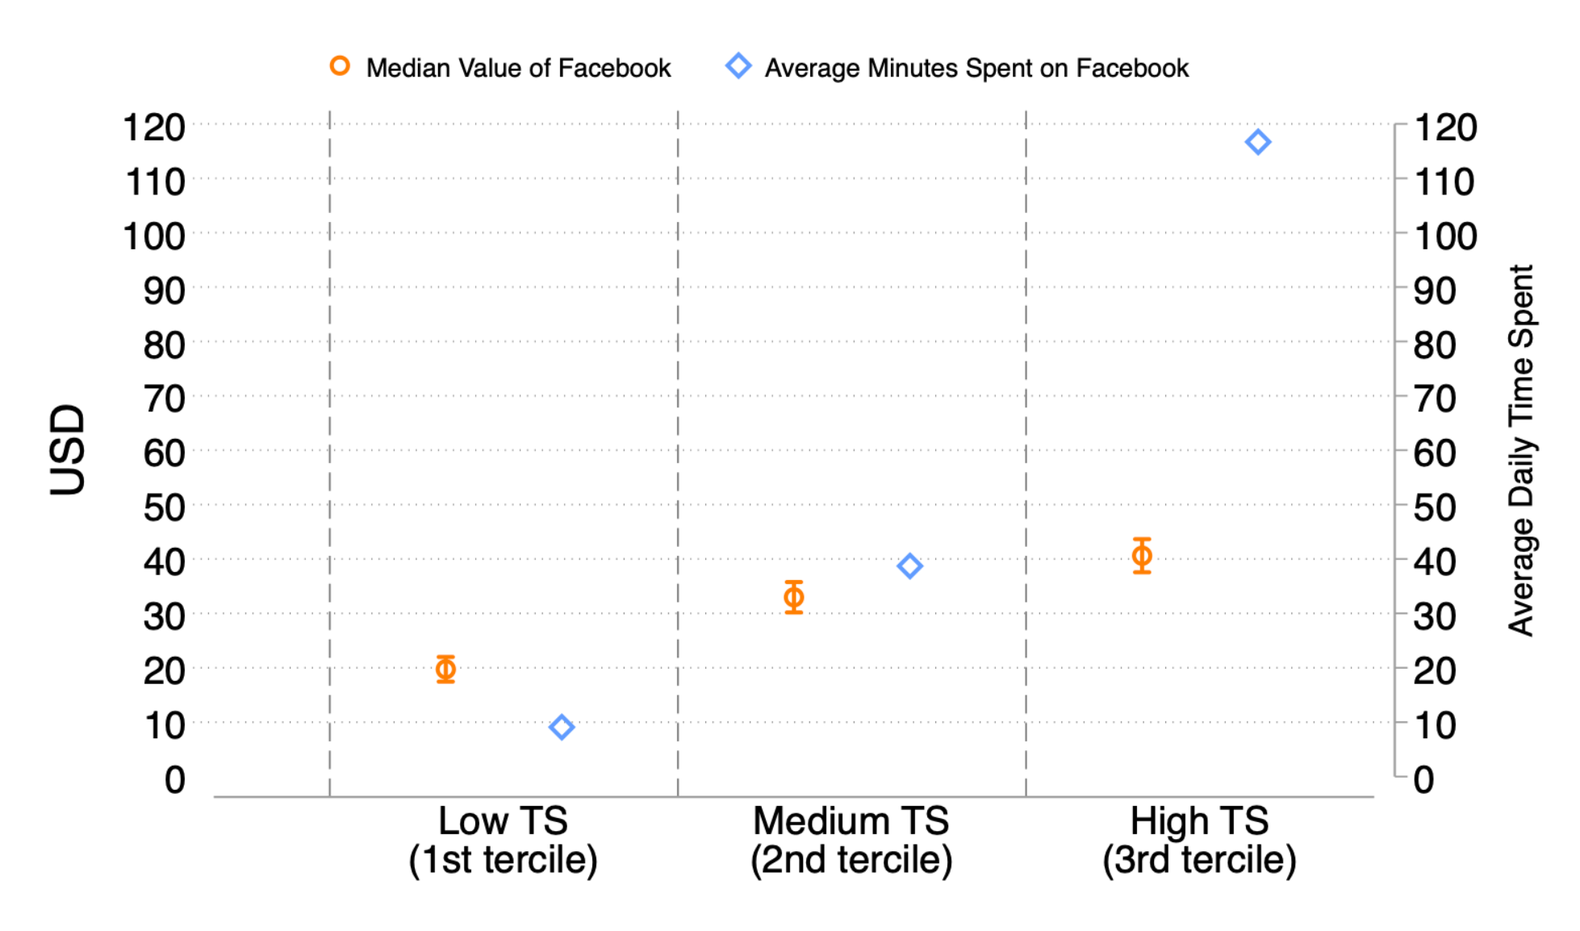
Consumer welfare vs. time spent
Valuation increases much more slowly than time spent
Moving from the 1st tercile based on time spent to the 3rd tercile, FB value increases by 2.06 times (from $19.72 to $40.61) while time spent increases by 12.84 times

Slide 24
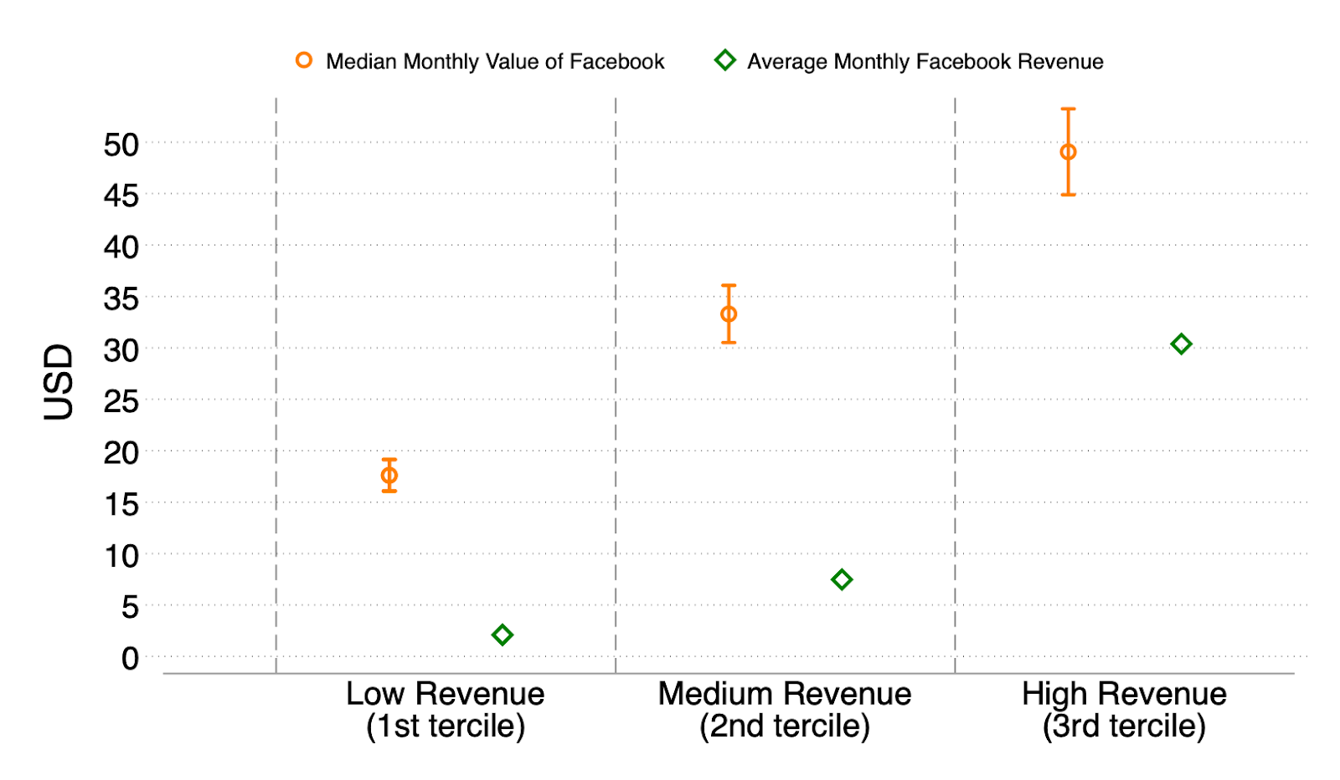
Consumer welfare vs. ad revenues
Ad revenue increases much more slowly than valuations
  User value in the 1st tercile 8.4X ad revenues
  User value in 3rd tercile 1.6X ad revenues
Majority of welfare gains go to consumers
  Consistent with Nordhaus (2004)
This is just for FB. For other digital goods such as WhatsApp or Wikipedia, no ad revenue.
Takeaway: Time spent and ad revenues are only weakly correlated with estimates of consumer surplus of FB

Slide 25

Accounting for the benefits from digitization
We introduce a new metric, we call “GDP-B” (B=benefits) to account for the benefits of free goods and new goods

Slide 26
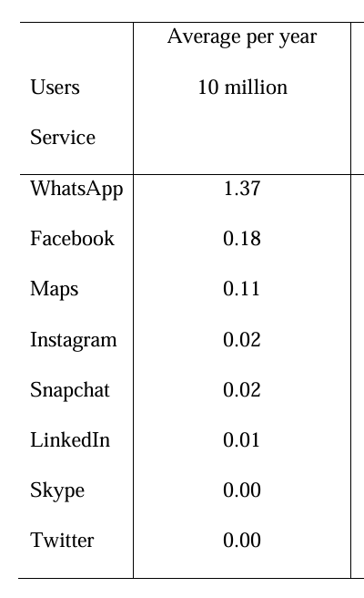
Accounting for the benefits from digitization
Between 2004-17, including the gains from Facebook alone adds 0.05 to 0.11 percentage points to GDP-B growth per year
Improvements in smartphones (e.g. Camera) adds 0.63 percentage points growth per year

Slide 27
How much are people already benefiting from GenAI?
What is the willingness to accept (WTA) to give up all genAI tools (ChatGPT, Gemini, Claude etc.) for 1 month?
Survey users of GenAI tools end of 2024
  N = 2,000, representative of the US internet population (age, gender, education, region)

Slide 28
GenAI Usage
ChatGPT 84.5%
Gemini 51.1%
Copilot 31.1%
Grok 19.6%
Claude 12.5%
Perplexity 8.5%
Midjourney 5.8%

Slide 29
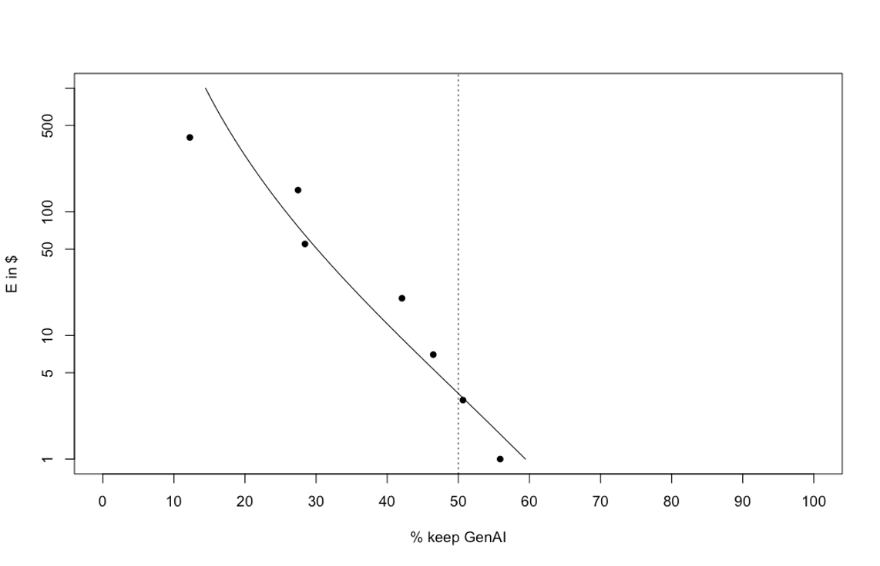
How much are people already benefiting from GenAI?
Among adopters (40% of the population), average valuation = $98/month
  This is the extra value they get on top of what they pay (0 if free version, $$ for paid versions)
Prefer to keep GenAI:
$1 | 55.9%
$3 | 50.6%
$7 | 46.5%
$20 | 42.1%
$55 | 28.4%
$150 | 27.5%
$400 | 12.2%
Demand curve for genAI tools for adopters

Slide 30
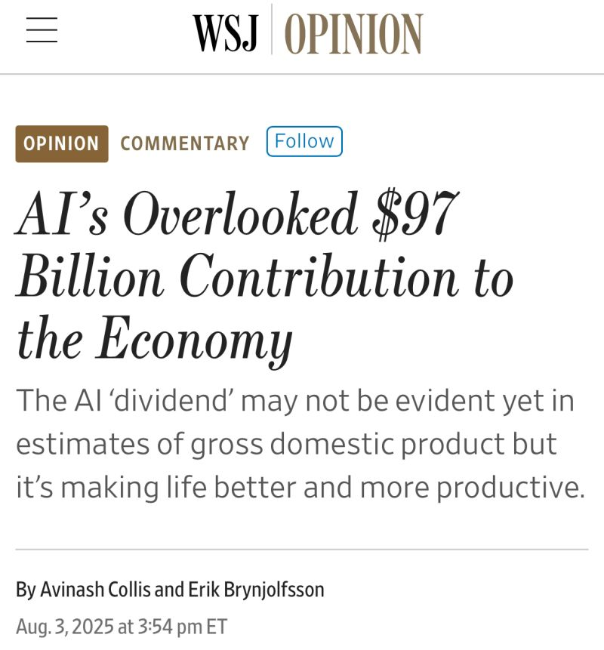
How much are people already benefitting from GenAI?
Total consumer welfare created by GenAI tools in 2024 in the US:
82.3 M US AI users * $98/ month * 12 = $97 billion/ yr
OpenAI US revenue in 2024 ~ $1 billion
  Other tools: Gemini, Claude, Meta etc., total US revenue in 2024 ~ $7 billion
~93% of welfare gains from gen AI went to consumers in 2024

Slide 31
Next steps?
Do this carefully with incentive compatibility
Heterogeneity across:
  Work vs. non-work use
  gender, age, education
  Income within and across countries (esp valuations relative to income)
Compare valuations vs. usage (number of messages, time spent)
Compare valuations vs. inference costs at the user level

Slide 32
Summary
GDP, developed in 1930s, remains the de facto metric of economic growth and widely used as a proxy for economic well-being.
Conceptually, consumer surplus is a better metric of economic well-being.
Online choice experiments have the potential to reinvent and significantly supplement the measurement of economic welfare.
Digital goods generate significant amounts of consumer welfare and reduce welfare inequality within and across countries.
Notes:
Change this

Slide 33
Next steps
Scaling up measurement of consumer welfare for a much bigger basked of goods including non digital goods -> See next talk by David Nguyen
Estimate the production of digital leisure services by households and their plausible inclusion in national statistics in a satellite account -> Ongoing work with Carmit Schwartz, Kevin Fox and John Lourenze Poquiz in collaboration with the Productivity Institute, ESCOE and UNSW

Slide 34

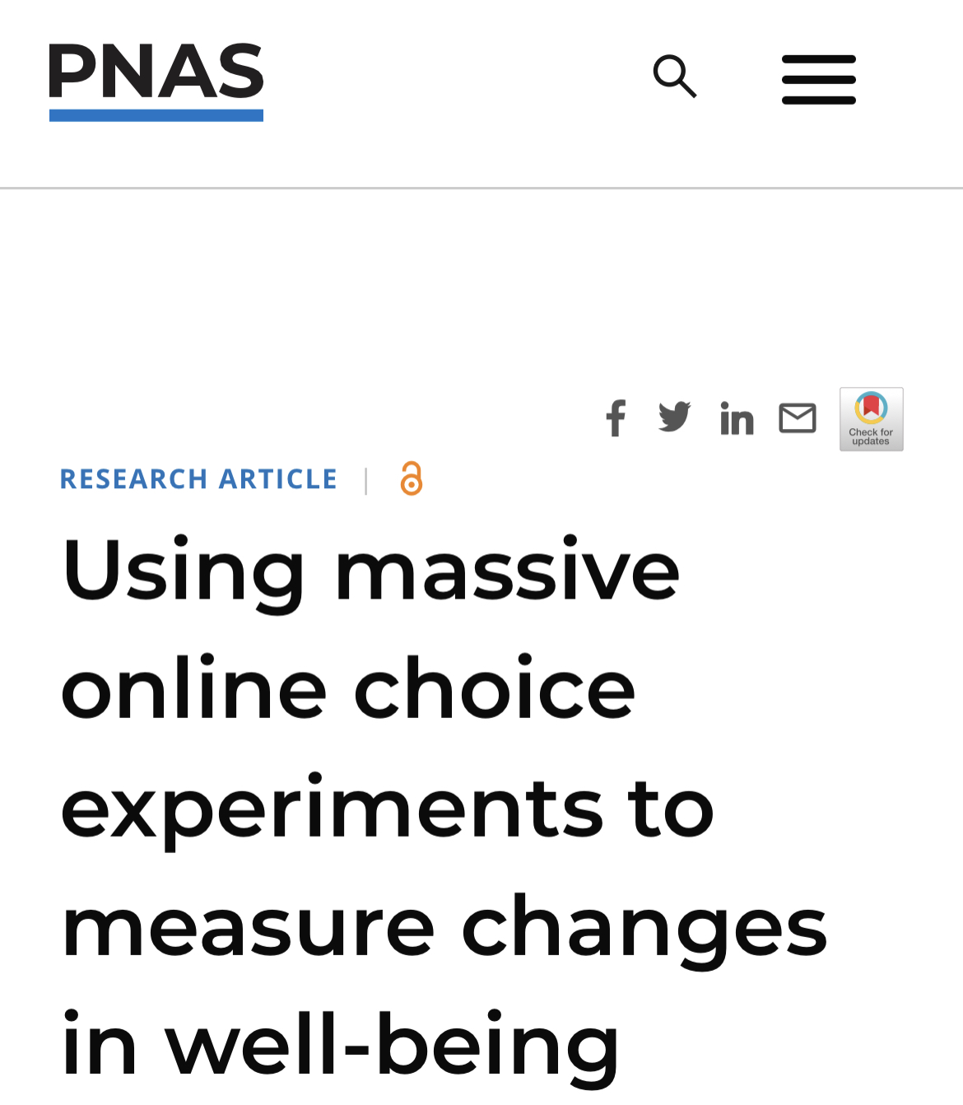
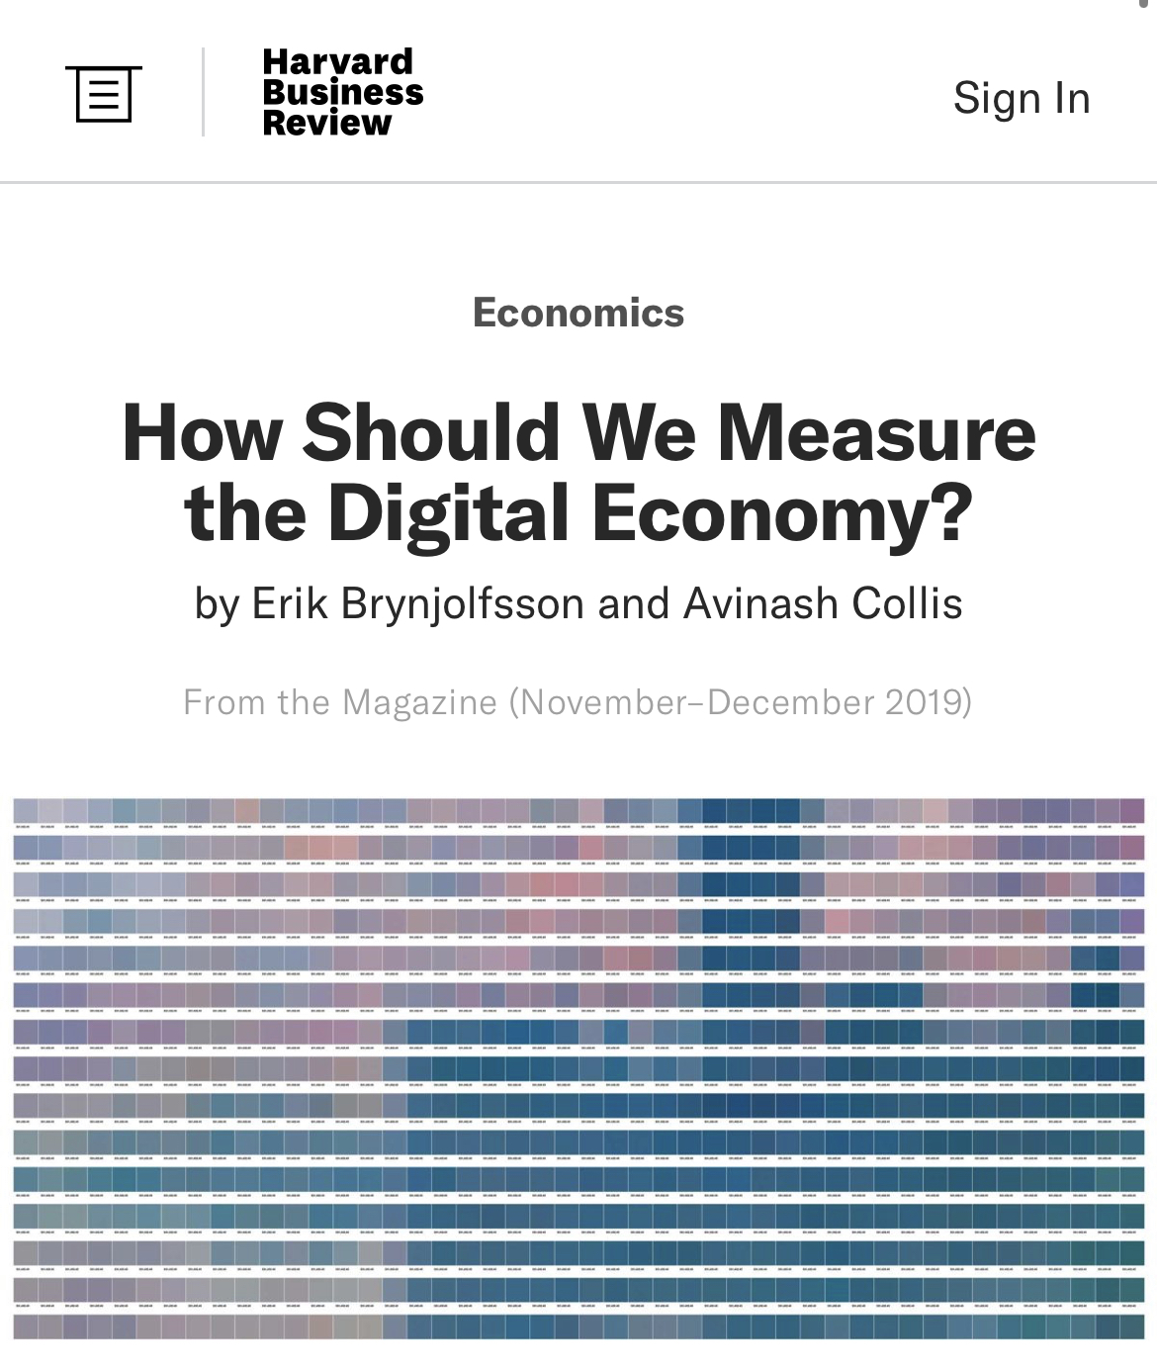

Thank you
Papers at: www.avinash.info

